Slide 1
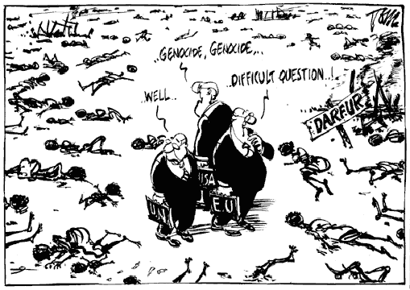
The Eight Stages of Genocide
Dr. Gregory Stanton
Genocide Watch
© 2007 Gregory Stanton

Slide 2
The 8 Stages of Genocide
Understanding the genocidal process is one of the most important steps in preventing future genocides.
The Eight Stages of Genocide were first outlined by Dr. Greg Stanton, Department of State: 1996.
The first six stages are Early Warnings:
    Classification
    Symbolization
    Dehumanization
    Organization
    Polarization
    Preparation

Slide 3
Stage 1: Classification
“Us versus them”
Distinguish by nationality, ethnicity, race, or religion.
Bipolar societies (Rwanda) most likely to have genocide because no way for classifications to fade away through inter-marriage.
Classification is a primary method of dividing society and creating a power struggle between groups.

Slide 4
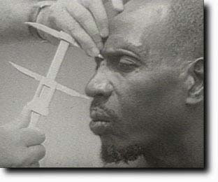
Classification (Rwanda)
Belgian colonialists believed Tutsis were a naturally superior nobility, descended from the Israelite tribe of Ham. The Rwandan royalty was Tutsi.
Belgians distinguished between Hutus and Tutsis by nose size, height & eye type. Another indicator to distinguish Hutu farmers from Tutsi pastoralists was the number of cattle owned.

Slide 5
Prevention: Classification
  Promote common identities (national, religious, human.)
  Use common languages (Swahili in Tanzania, science, music.)
  Actively oppose racist and divisive politicians and parties.

Slide 6

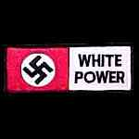
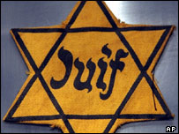
Stage 2: Symbolization
Names: “Jew”, “German”, “Hutu”, “Tutsi”.
Languages.
Types of dress.
Group uniforms: Nazi Swastika armbands
Colors and religious symbols:
    Yellow star for Jews
    Blue checked scarf Eastern Zone in Cambodia

Slide 7
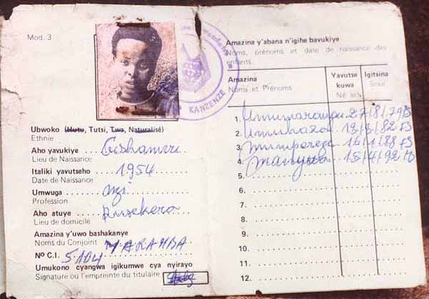
Stage 2: Symbolization (Rwanda)
“Ethnicity” was first noted on cards by Belgian Colonial Authorities in 1933.
Tutsis were given access to limited education programs and Catholic priesthood. Hutus were given less assistance by colonial auhorities.
At independence, these preferences were reversed. Hutus were favored.
These ID cards were later used to distinguish Tutsis from Hutus in the 1994 massacres of Tutsis and moderate Hutus that resulted in 800,000+ deaths.

Slide 8

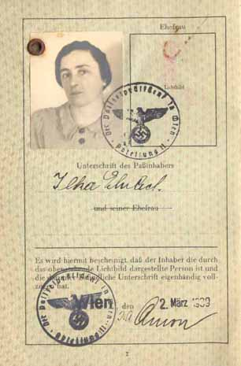
Symbolization (Nazi Germany)
Jewish Passport: “Reisepäss”
Required to be carried by all Jews by 1938. Preceded the yellow star.

Slide 9
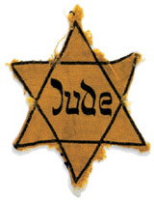
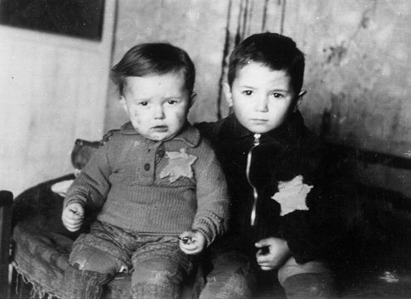
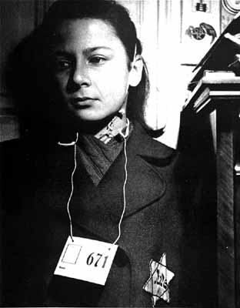
Symbolization (Nazi Germany)
Nazis required the yellow Star of David emblem to be worn by nearly all Jews in Nazi-occupied Europe by 1941.

Slide 10
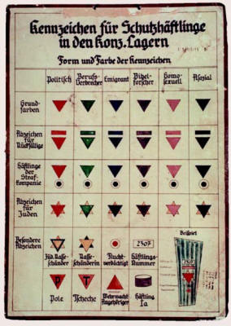
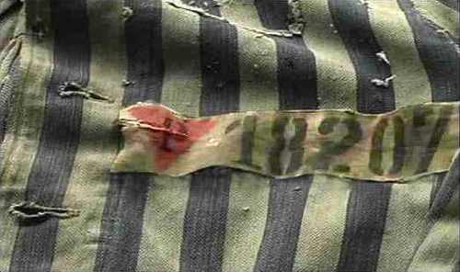
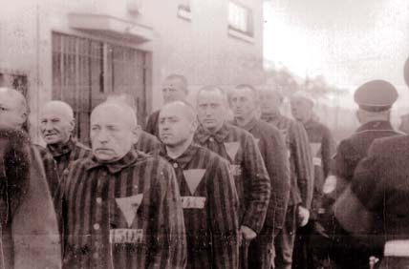
Symbolization (Nazi Germany)
Homosexuals = pink triangles
Identified homosexuals to SS guards in the camps
Caused discrimination by fellow inmates who shunned homosexuals

Slide 11
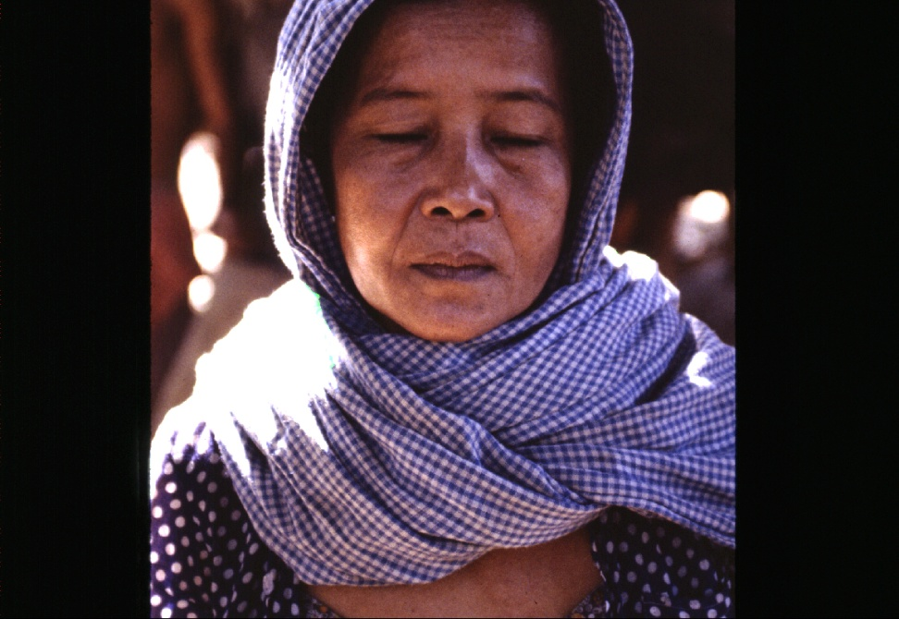
Symbolization (Cambodia)
People in the Eastern Zone, near Vietnam, were accused of having “Khmer bodies, but Vietnamese heads.”
They were deported to other areas to be worked to death.
They were marked with a blue and white checked scarf (Kroma)

Slide 12
Prevention: Symbolization
Get ethnic, religious, racial, and national identities removed from ID cards, passports.
Protest imposition of marking symbols on targeted groups (yellow cloth on Hindus in Taliban Afghanistan).
Protest negative or racist words for groups. Work to make them culturally unacceptable.

Slide 13
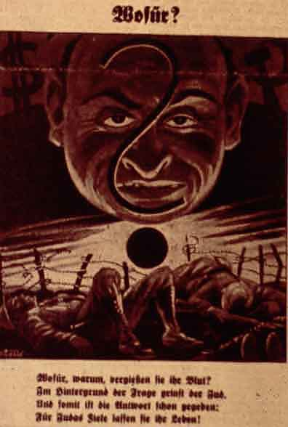
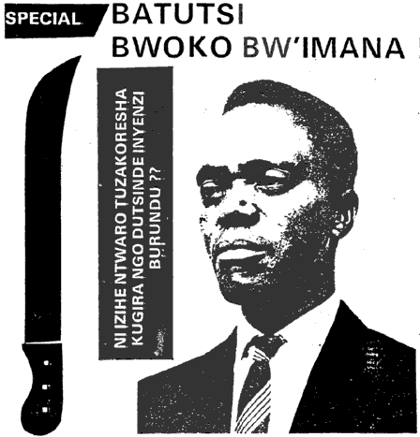
Stage 3: Dehumanization
One group denies the humanity of another group, and makes the victim group seem subhuman.
Dehumanization overcomes the normal human revulsion against murder.
Der Stürmer Nazi Newspaper:
“The Blood Flows; The Jew Grins”
Kangura Newspaper, Rwanda: “The Solution for Tutsi Cockroaches”
.

Slide 14
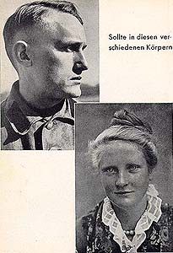
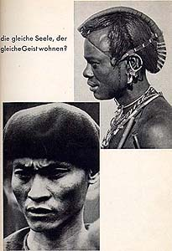
Dehumanization
From a Nazi SS Propaganda Pamphlet:
Caption: Does the same soul dwell in these bodies?

Slide 15
Dehumanization
Hate propaganda in speeches, print and on hate radios vilify the victim group.
Members of the victim group are described as animals, vermin, and diseases. Hate radio, Radio Télévision Libre des Mille Collines, during the Rwandan genocide in 1994, broadcast anti-Tutsi messages like “kill the cockroaches” and “If this disease is not treated immediately, it will destroy all the Hutu.”
Dehumanization invokes superiority of one group and inferiority of the “other.”
Dehumanization justifies murder by calling it “ethnic cleansing,” or “purification.” Such euphemisms hide the horror of mass murder.

Slide 16
Prevention: Dehumanization
Vigorously protest use of dehumanizing words that refer to people as “filth,” “vermin,” animals or diseases. Deny people using such words visas and freeze their foreign assets and contributions.
Prosecute hate crimes and incitements to commit genocide.
Jam or shut down hate radio and television stations where there is danger of genocide.

Slide 17
Prevention: Dehumanization
Provide programs for tolerance to radio, TV, and newspapers.
Enlist religious and political leaders to speak out and educate for tolerance.
Organize inter-ethnic, interfaith, and inter-racial groups to work against hate and genocide.

Slide 18
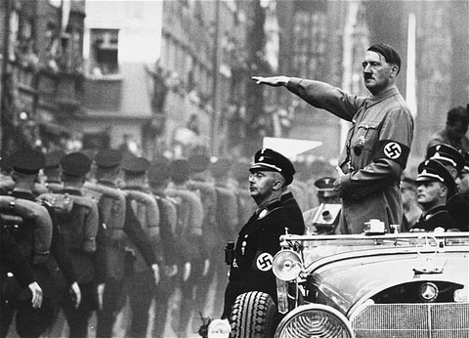
Stage 4: Organization
Genocide is a group crime, so must be organized.
The state usually organizes, arms and financially supports the groups that conduct the genocidal massacres. (State organization is not a legal requirement --Indian partition.)
Plans are made by elites for a “final solution” of genocidal killings.

Slide 19
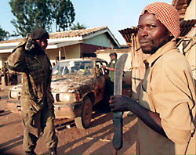
Organization (Rwanda)
“Hutu Power” elites armed youth militias called Interahamwe ("Those Who Stand Together”).
The government and Hutu Power businessmen provided the militias with over 500,000 machetes and other arms and set up camps to train them to “protect their villages” by exterminating every Tutsi.

Slide 20
Prevention: Organization
Treat genocidal groups as the organized crime groups they are. Make membership in them illegal and demand that their leaders be arrested.
Deny visas to leaders of hate groups and freeze their foreign assets.
Impose arms embargoes on hate groups and governments supporting ethnic or religious hatred.
Create UN commissions to enforce such arms embargoes and call on UN members to arrest arms merchants who violate them.

Slide 21
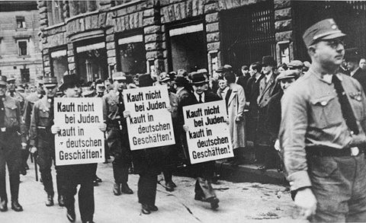
Stage 5: Polarization
Extremists drive the groups apart.
Hate groups broadcast and print polarizing propaganda.
Laws are passed that forbid intermarriage or social interaction.
Political moderates are silenced, threatened and intimidated, and killed.
Public demonstrations were organized against Jewish merchants.
Moderate German dissenters were the first to be arrested and sent to concentration camps.

Slide 22
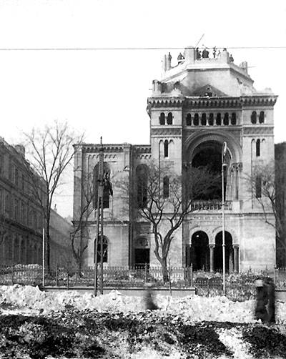
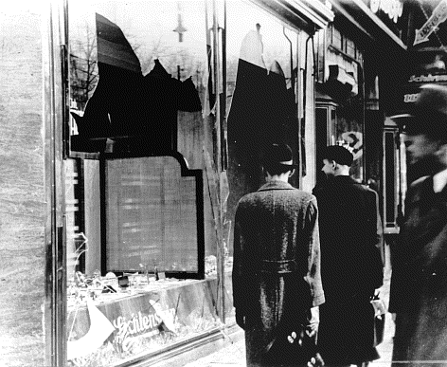
Polarization
Attacks are staged and blamed on targeted groups.
In Germany, the Reichstag fire was blamed on Jewish Communists in 1933.
Cultural centers of targeted groups are attacked.
On Kristalnacht in 1938, hundreds of synagogues were burned.

Slide 23
Prevention: Polarization
Vigorously protest laws or policies that segregate or marginalize groups, or that deprive whole groups of citizenship rights.
Physically protect moderate leaders, by use of armed guards and armored vehicles.
Demand the release of moderate leaders if they are arrested. Demand and conduct investigations if they are murdered.
Oppose coups d’état by extremists.

Slide 24
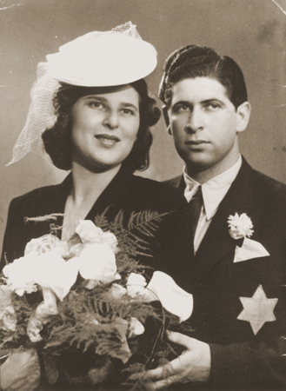
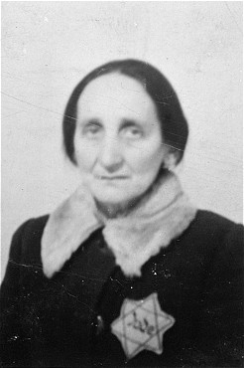
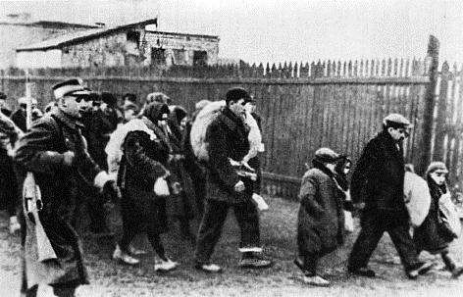
Stage 6: Preparation
Members of victim groups are forced to wear identifying symbols.
Death lists are made.
Victims are separated because of their ethnic or religious identity.

Slide 25
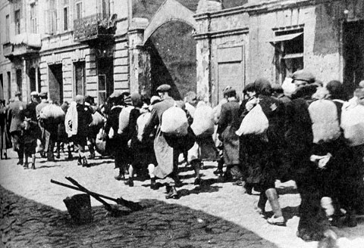
Preparation
Segregation into ghettoes is imposed, victims are forced into concentration camps.
Victims are also deported to famine-struck regions for starvation.
Forced Resettlement into Ghettos – Poland 1939 - 1942

Slide 26
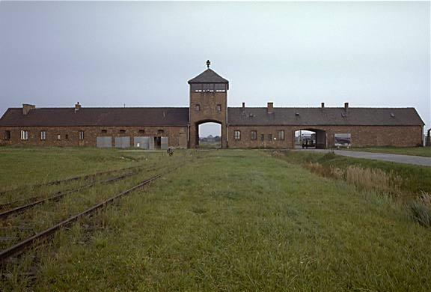
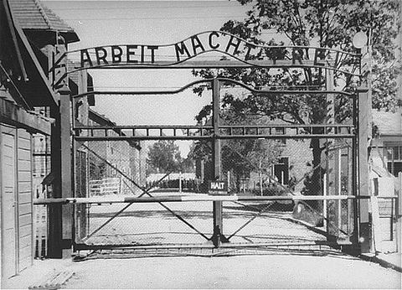
Preparation
Weapons for killing are stock-piled.
Extermination camps are even built. This build- up of killing capacity is a major step towards actual genocide.

Slide 27
Prevention: Preparation
With evidence of death lists, arms shipments, militia training, and trial massacres, a Genocide Alert™ should be declared.
UN Security Council should warn it will act (but only if it really will act.)
Diplomats must warn potential perpetrators.
Humanitarian relief should be prepared.
Military intervention forces should be organized, including logistics and financing.

Slide 28
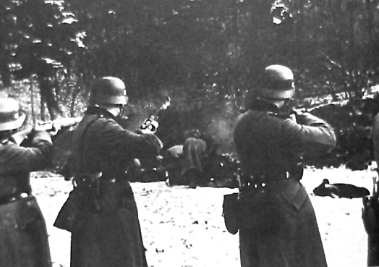
Stage 7: Extermination (Genocide)
Extermination begins, and becomes the mass killing legally called "genocide." Most genocide is committed by governments.
Einsatzgrupen: Nazi Killing Squads

Slide 29
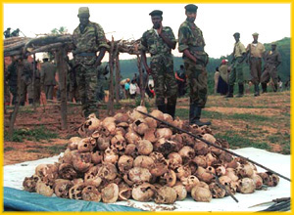
Extermination (Genocide)
Government organized extermination of Tutsis in Rwanda in 1994

Slide 30
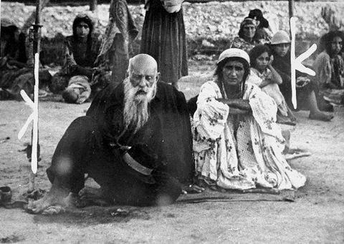
Extermination (Genocide)
The killing is “extermination” to the killers because they do not believe the victims are fully human. They are “cleansing” the society of impurities, disease, animals, vermin, “cockroaches,” or enemies.
Roma (Gypsies) in a Nazi death camp

Slide 31
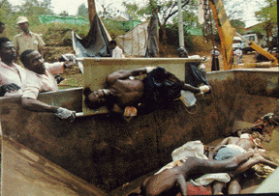
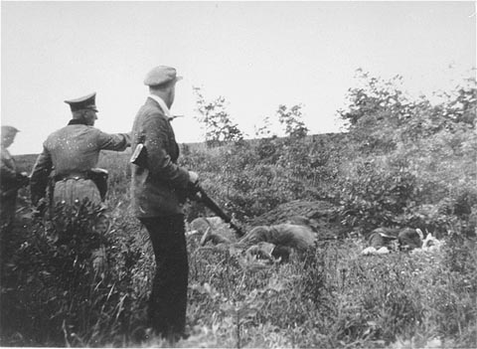
Extermination (Genocide)
Although most genocide is sponsored and financed by the state, the armed forces often work with local militias.
Rwandan militia killing squads
Nazi killing squad working with local militia

Slide 32
Extermination: Stopping Genocide
Regional organizations, national governments, and the UN Security Council should impose targeted sanctions to undermine the economic viability of the perpetrator regime.
Sales of oil and imports of gasoline should be stopped by blockade of ports and land routes.
Perpetrators should be indicted by the International Criminal Court.

Slide 33
Extermination: Stopping Genocide
The UN Security Council should authorize armed intervention by regional military forces or by a UN force under Chapter Seven of the UN Charter.
  The Mandate must include protection of civilians and humanitarian workers and a No Fly Zone.
  The Rules of Engagement must be robust and include aggressive prevention of killing.
  The major military powers must provide leadership, logistics, airlift, communications, and financing.
  If the state where the genocide is underway will not permit entry, its UN membership should be suspended.

Slide 34
Stage 8: Denial
Denial is always found in genocide, both during it and after it.
Continuing denial is among the surest indicators of further genocidal massacres.
Denial extends the crime of genocide to future generations of the victims. It is a continuation of the intent to destroy the group.
The tactics of denial are predictable.

Slide 35
Denial: Deny the Evidence.
Deny that there was any mass killing at all.
Question and minimize the statistics.
Block access to archives and witnesses.
Intimidate or kill eye-witnesses.

Slide 36
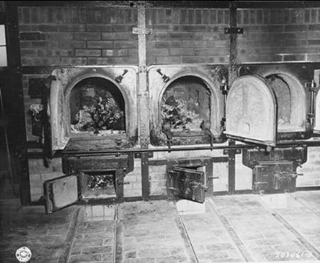
Denial: Deny the Evidence
Destroy the evidence. (Burn the bodies and the archives, dig up and burn the mass graves, throw bodies in rivers or seas.)
Holocaust Death-Camp Crematoria

Slide 37
Denial: Attack the truth-tellers.
Attack the motives of the truth-tellers. Say they are opposed to the religion, ethnicity, or nationality of the deniers.
Point out atrocities committed by people from the truth-tellers’ group. Imply they are morally disqualified to accuse the perpetrators.

Slide 38
Denial: Deny Genocidal Intent.
Claim that the deaths were inadvertent (due to famine, migration, or disease.)
Blame “out of control” forces for the killings.
Blame the deaths on ancient ethnic conflicts.

Slide 39
Denial: Blame the Victims.
Emphasize the strangeness of the victims. They are not like us. (savages, infidels)
Claim they were disloyal insurgents in a war.
Call it a “civil war,” not genocide.
Claim that the deniers’ group also suffered huge losses in the “war.” The killings were in self-defense.

Slide 40
Denial: Deny for current interests.
Avoid upsetting “the peace process.” “Look to the future, not to the past.”
Deny to assure benefits of relations with the perpetrators or their descendents. (oil, arms sales, alliances, military bases)
Don’t threaten humanitarian assistance to the victims, who are receiving good treatment. (Show the model Thereisenstadt IDP camp.)

Slide 41
Denial: Deny facts fit legal definition of genocide.
  They’re crimes against humanity, not genocide.
  They’re “ethnic cleansing”, not genocide.
  There’s not enough proof of specific intent to destroy a group, “as such.” (“Many survived!”-
  UN Commission of Inquiry on Darfur.)
  Claim the only “real” genocides are like the Holocaust: “in whole.”
  (Ignore the “in part” in the Genocide Convention.)
  Claim declaring genocide would legally obligate us to intervene. (We don’t want to intervene.)

Slide 42
Preventing Genocide
  By Dr. Gregory Stanton
  Copyright 2007 Gregory Stanton

Slide 43
Why has the UN not stopped genocide ?
Genocide succeeds when state sovereignty blocks international responsibility to protect.
The UN represents states, not peoples.
Since founding of UN:
  Over 45 genocides and politicides
  Over 70 million dead
Genocide prevention ≠ conflict resolution

Slide 44
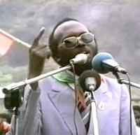
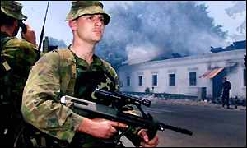
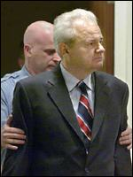
Prevention requires:
Early
warning
2. Rapid
response
3. Courts for
accountability

Slide 45
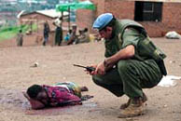
Genocide continues due to:
Lack of authoritative international
institutions to predict it
•Lack of ready rapid response forces to stop it
UNAMIR peacekeeper in Rwanda, April 1994

Slide 46
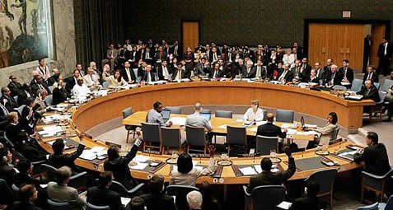
Genocide continues due to:
Lack of political will to peacefully prevent it
and to forcefully intervene to stop it
UN Security Council votes to withdraw
UNAMIR troops from Rwanda, April 1994

Slide 47
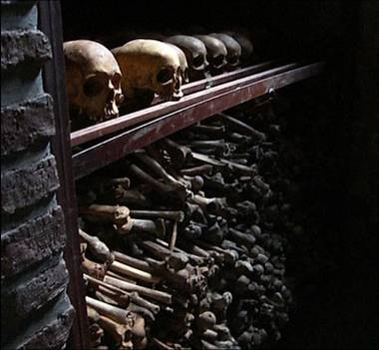
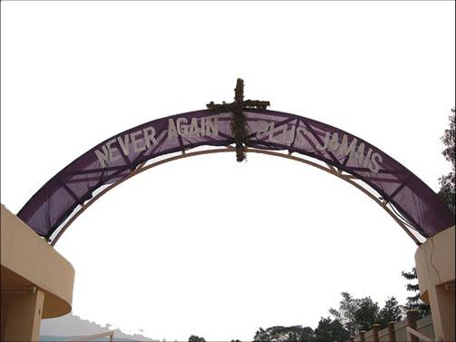
Memorial to 800,000 Rwandans murdered,
April – July, 1994

Slide 48
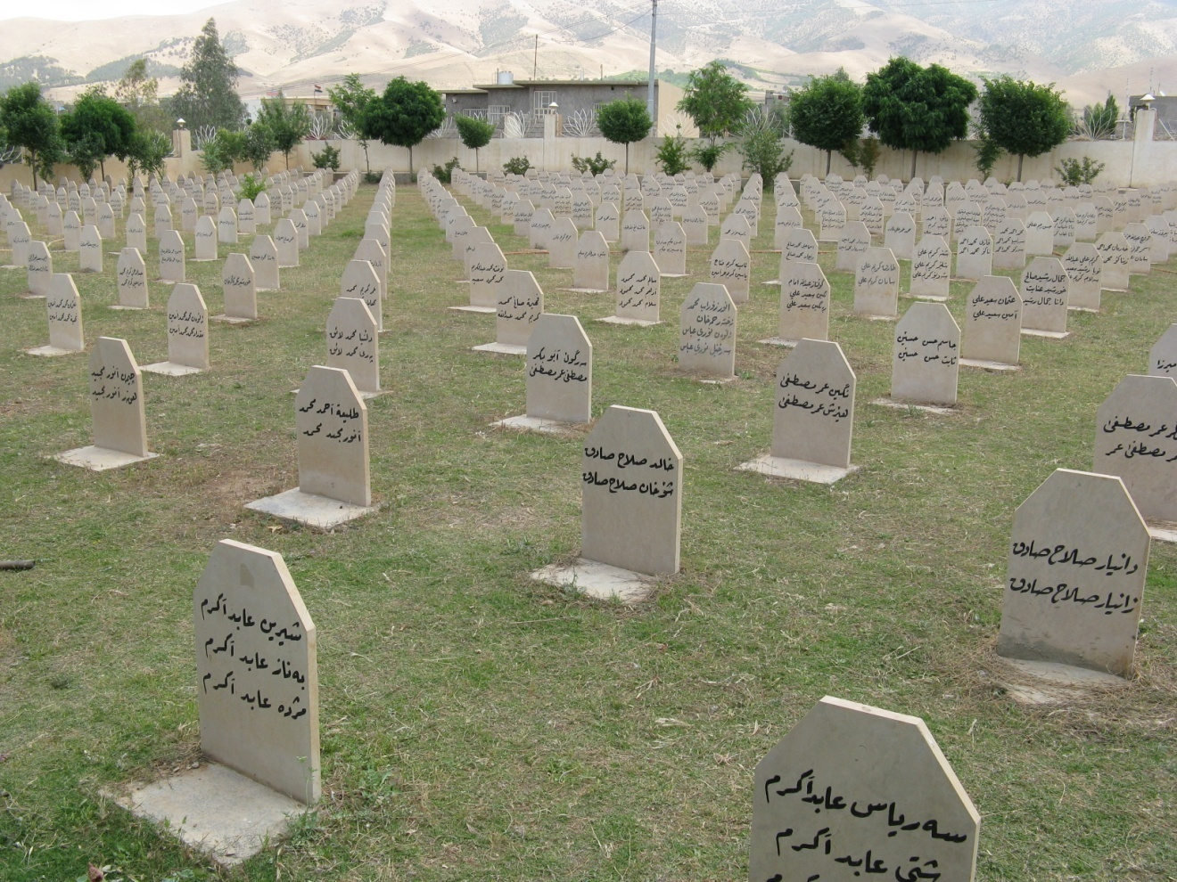
Halabja, Kurdistan, Iraq
Memorial to 5000 killed in chemical attack 16 March 1988. 182,000 Kurds died in Anfal genocide.

Slide 49
Prevention: Political Will
Build an international mass movement to end genocide in this century.
  Organize civil society and human rights groups.
  Mobilize religious leaders of churches, mosques, synagogues, and temples.
  Put genocide education in curricula of every secondary school and university in the world.
  Hold political leaders accountable. If they fail to act to stop genocide, vote them out of office.

Slide 50
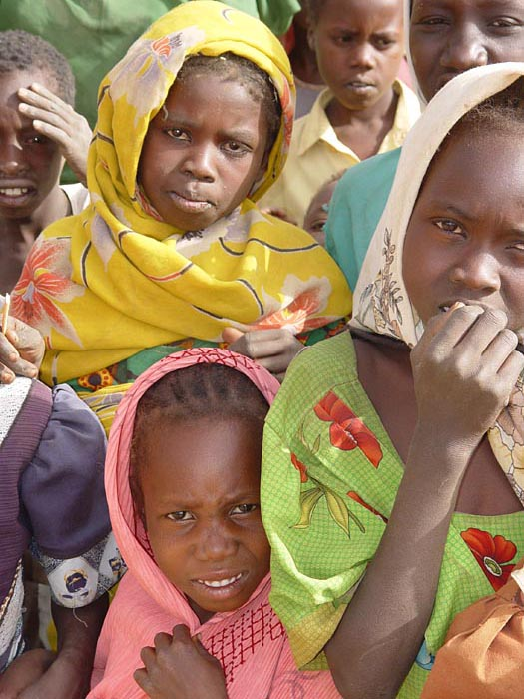
Never Again? Or Again and Again?
How can we use the 8 Stages of Genocide to develop more effective ways to prevent genocide in the future?
Would it be useful for the UN to establish a Genocide Prevention Center to work with the Special Adviser for Genocide Prevention?
Even with Early Warning, how can we achieve effective Early Response to prevent and stop genocide?

