Slide 1
Types of Government
Why do we have governments and what are the different forms they take throughout human history?

Slide 2
Need For Government
Government: The ruling authority for a community or society. Any organization with the power to make and enforce laws for its members.
Functions of Government:
1. Keep order: prevent conflicts; settle them when they occur
2. Provide security: military and police
3. Provide public services: keep public healthy and safe. Ex: fire departments, driver’s licenses, test water

Slide 3
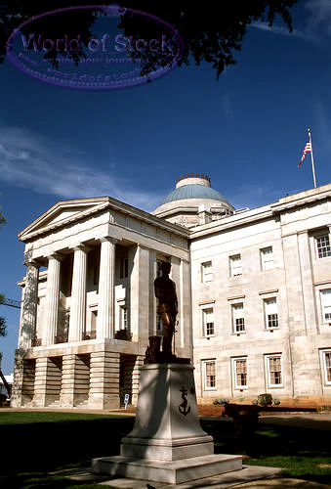
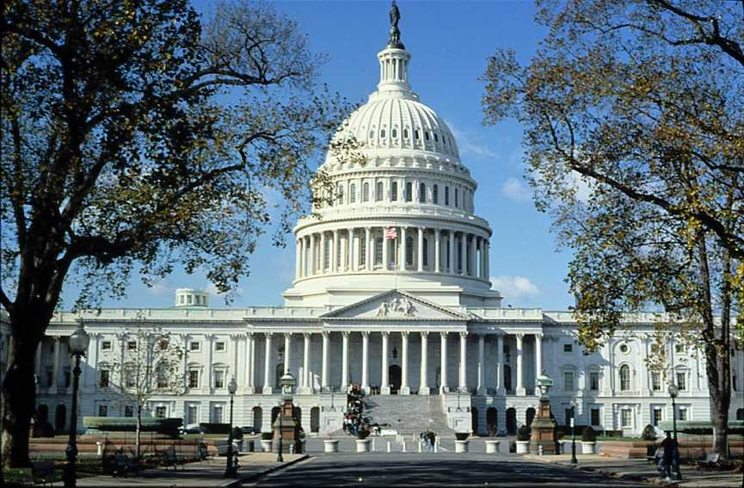
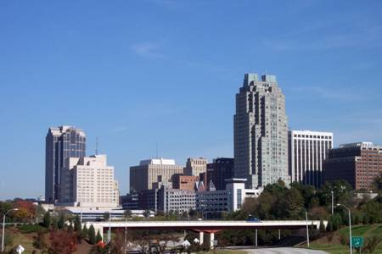
Levels of Government
National: The government of an entire country. In the USA, the national government is also called the Federal Government.
State: The government of a specific region or area of a country; in the USA we call these states. Other countries call them provinces, prefects, regions, etc.
Local: The government of a small area, usually a county, city, or town.

Slide 4
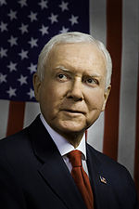
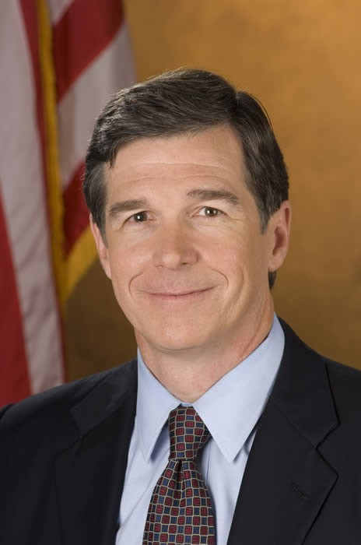
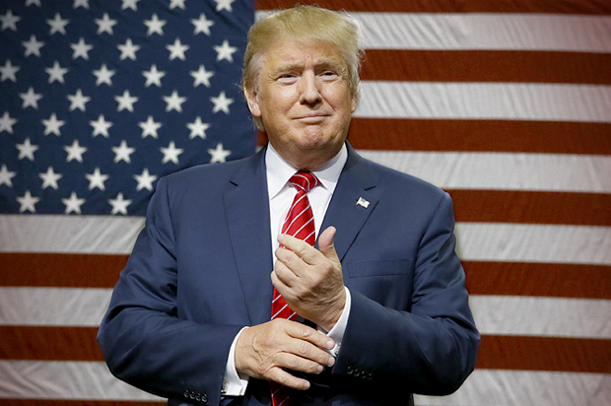
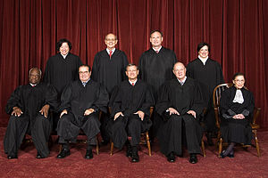
Branches of Government
Legislative: Makes laws
-Ex: US Congress, NC General Assembly
Executive: Enforces laws
- President Donald Trump, Governor Roy Cooper
Judicial: Interprets laws
- Courts

Slide 5
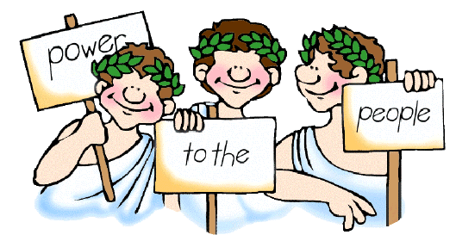
Types of Government
Democracy: Government by the citizens/people
-Direct Democracy: All citizens have the chance to vote for any law or action.
- Representative Democracy: citizens elect people to represent them in making government decisions.

Slide 6
Other Types of Government
- Monarchy: a King or Queen controls the entire government and makes all decisions
Constitutional monarchy: the King or Queen shares power with a legislative body, often called the parliament
Dictatorship/Autocracy/Totalitarian State: A single ruler completely controls the government and all decision-making. This person usually came to power by military force.
Theocracy: Government is controlled by religious leaders
Oligarchy: Government of the few; often a small group of wealthy nobles/aristocrats

Slide 7
English Political Traditions
What aspects of the English government do we use in the US today?

Slide 8
The Magna Carta
England’s government has historically been a monarchy
The Magna Carta: In 1215, King John I was forced to sign a document called the Magna Carta which guaranteed certain rights to the citizens of England. Important rights established and adopted by the US government include:
1. Trial with a jury. They are presumed innocent until proven guilty.
2. All citizens are guaranteed justice
3. All citizens, regardless of class, must follow the same laws and will be punished in the same way if they break a law (Rule of Law)

Slide 9
The Parliament
The Parliament: Originally a group of advisors to the monarch, the Parliament slowly took on more and more power. Today the Parliament has all powers of government in England.
Following the Glorious Revolution in 1688, the Parliament passed the English Bill of Rights. Important parts of the English Bill of Rights:
Members of Parliament elected
No cruel and unusual punishment
Freedom of speech
A checks and balances system with the King and Parliament

Slide 10
Common Law
England’s laws have not always been written down in the way that we have today. This type of system is called Common Law.
English common law is the most influential form of law on the American legal system
Common Law: A system of law based on customs and precedents.
Precedent: a decision or ruling in a court case which is used as a basis for similar cases.

Slide 11
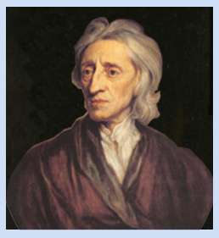
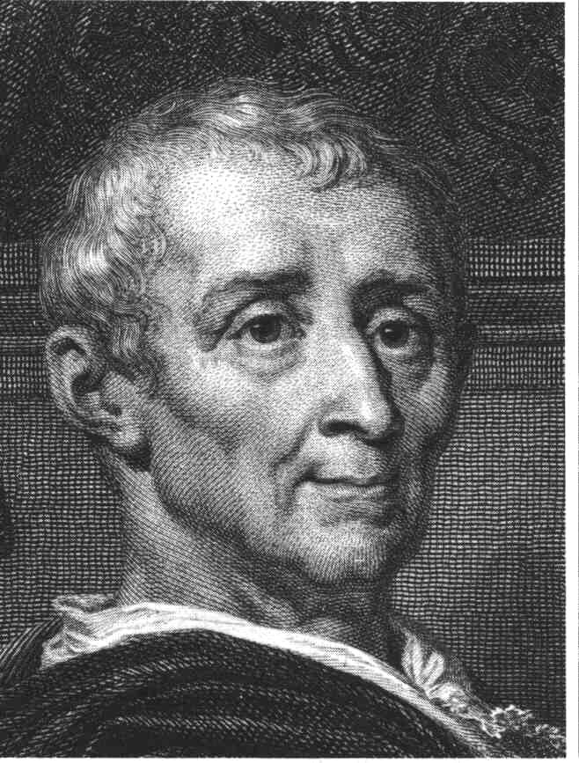
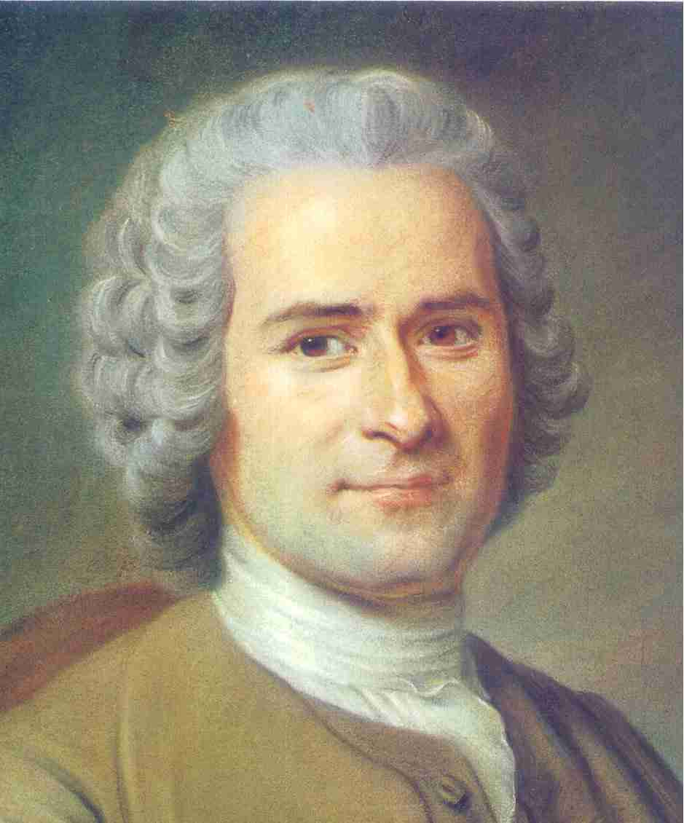
Enlightenment Philosophy
The Enlightenment was a time when people in Europe began to question the traditional ideas about government and power, and came up with new ideas about who should be involved in government.
Several important writers of the 1700s helped pave the way for the American Revolution.

Slide 12
John Locke
The most important Enlightenment philosopher in the design of the government of the United States.
Natural Rights: purpose of government is to protect the natural rights of citizens; these rights are “life, liberty, and property”
Social Contract: people in a society agree to give up some of their freedom in exchange for protection of their natural rights by a government
Pushed for a representative government.

Slide 13
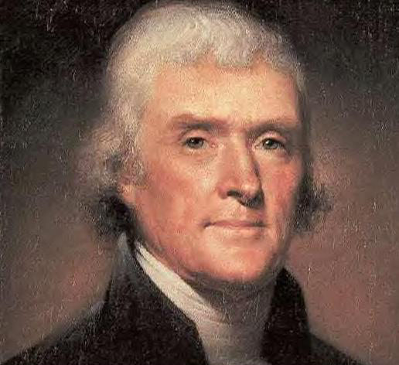
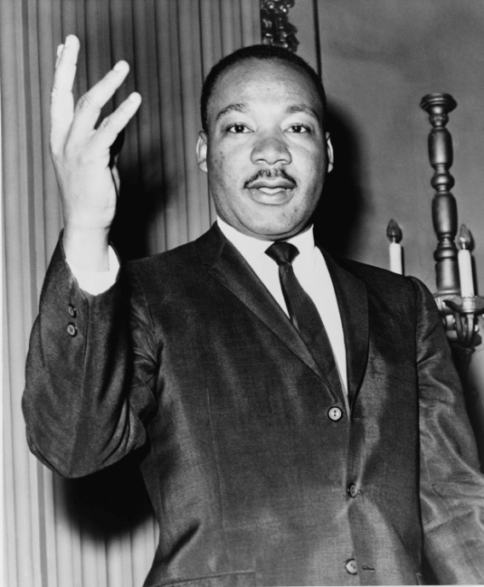
Montesquieu and Rousseau
Baron de Montesquieu: Separation of Powers → powers of government should be divided into branches
Jean-Jacques Rousseau: “All Men Are Created Equal”

