Slide 1
Citizenship in the United States of America
Essential Questions: What does it mean to be a citizen in this country and how does a person become a citizen? Why are civic responsibilities like volunteering important?

Slide 2
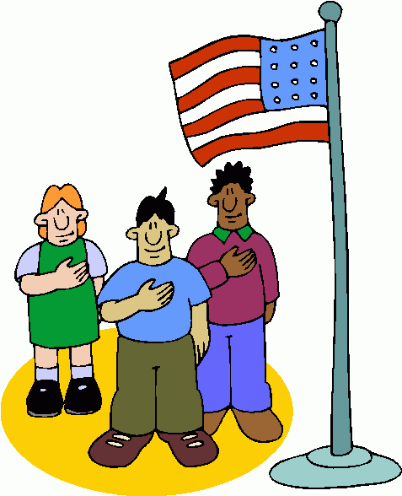
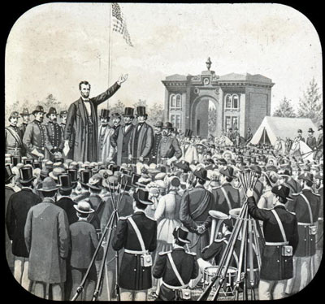
Citizens and Government
Citizens: members of a community who owe their loyalty to the government of the community and are entitled to government services.
Government: the ruling authority for a community. Allows distribution of resources and provides order in a society. Governments should help citizens meet their needs.
Abraham Lincoln – “The US government is of the people, for the people, and by the people.”
- Of the people: the government rules by consent of the governed; it gets its power from the citizens.
- For the people: the actions of the government should benefit the citizens.
- By the people: regular citizens are the people who participate in government.

Slide 3
Who are America’s Citizens?
Become a US citizen by being born in the US or being naturalized.
Alien: non-citizen living in a country for a specific period of time.
Immigrant: non-citizen who has permanently moved to a new country.
Citizenship and Immigration Services (USCIS): oversees naturalization.
Naturalization Process:
1. Be a Lawful Permanent Resident of the United States: apply and pay $985.
2. Live in US for five years (only three if married to a US citizen)
3. Apply for citizenship, pay fee of $595 and provide Biometric data ($85).
4. Interview with an INS official.
5. Take the citizenship test.
6. Ceremony and take oath of allegiance.

Slide 4
Legal v. Illegal Aliens
Anyone who is living in the country who is not a citizen is called an “alien”.
Only about 675,000 allowed each year (quota). People with family members already in US or with a special skill get preference.
Undocumented Residents (Illegal Aliens): at least 5-6 million, get deported if caught.
Amnesty: The idea of granting citizenship to all illegal aliens
Legal Aliens: can work, own property, attend school, receive government services, pay taxes. Can’t run for office, vote, serve on a jury, and must carry a picture ID at all times.

Slide 5
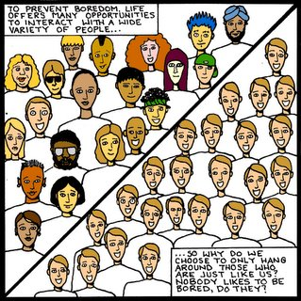
A Nation of Immigrants
Every person in the US is an immigrant or the descendant of an immigrant.
“E Pluribus Unum”: Out of many, one.
Diversity in Population: 64% non-Latino whites, 13% black, 5% Asian, 1% American Indian, 3% multiracial, 6 % other (16.3 % Latino: not a race, Latino is an ethnicity).
Diversity in Religion.

Slide 6
Responsibilities and Duties of American Citizens

Slide 7
Responsibilities
Actions that American citizens SHOULD take in order to contribute positively to our society
Examples: Voting, volunteering, picketing, petitioning government officials, running for political office, tolerance, earning a quality education, finding a job, etc.

Slide 8
Duties
Actions that American citizens MUST take in order to contribute positively to our society and avoid going to jail ☺
Examples: Jury duty, Registering for the Selective Service, Paying taxes, sending children to school, following all laws,

