Slide 1
Unit 9
Businesses and Government in the Economy

Slide 2
Business
Business Types, Costs and Revenue

Slide 3
Business
A person that starts a business is an entrepreneur.
Four elements of business
1. Expenses
2. Advertising
3. Receipts and record keeping
4. Risk: (profit vs. loss)
Ideas to consider:
1. Establish an inventory.
2. Technology.
3. Time: Consider opportunity cost.

Slide 4
Business Costs
Fixed Costs: Expenses that are the same no matter how much is produced.
Examples: Mortgage payment, property taxes
Variable Costs: Expenses that change with the number of items produced. These increase as production grows and decreases as production declines.
Examples: Wages and raw materials
Total Costs: Fixed Costs + Variable Costs
Marginal Costs: the additional cost of producing one more unit.

Slide 5
Business Revenue
Total Revenue: Number of items sold times the cost of that item. (40 drinks sold at a $1 each = $40 of total revenue)
Marginal Revenue: the change in total revenue when selling one more unit.
Marginal Benefit: the benefit received when producing one more unit of something.
Cost-Benefit Analysis: the choice made by the consumer when deciding if the benefits outweigh the costs. If they do not, the chosen option should be rejected.

Slide 6
Business Types Sole Proprietorship: Owned and operated by one person
Advantages
Disadvantages
Full pride in owning the business
Receive all profits
Quick decisions because no consultation, no boss
Relatively low taxes
Unlimited liability – the owner is financially responsible for any and all problems
Handle all decisions
Business depends on one person
Time consuming
Difficult to raise financial capital – the money needed to run a business or enable it to grow larger

Slide 7
Partnership
Advantages
Disadvantages
Losses are shared
More efficient that proprietorships
Pay taxes on share of profit
Easier to borrow money
Can usually raise more money
Each owner can bring their own talents
Profits are shared
Unlimited liability
Must reach agreements
Committed partners
Legal structure difficult

Slide 8
Partnerships
When they start a business, partners draw up a legal agreement called articles of partnership, which identifies how much money each will contribute and what role each will play in the business. It also clarifies how they will share profits or losses.
Limited partnership: Partners are not equal.
General partner: Majority of control.
Limited partner: Own a small part of the business. They do not voice opinions. They are only responsible for what they put in.
Joint Ventures: Temporary partnership to do a job.

Slide 9
Corporations
Owned by many people. Treated as one person.
Started by a founder and owned by stockholders.
State government issues a corporate charter to run the business.
The charter also specifies the amount of stock, or ownership shares of the corporation, that will be issued.
Stockholders will buy these stocks and become the owners of the corporation.

Slide 10
Corporations
Advantages
Disadvantages
Owners do not have to devote time to make money.
Stockholders have limited liability; they only lose what they put in.
Individuals trained in specific areas make decisions.
Decisions are slow. Interest of the board may differ from the stockholders.
Often expensive and complex to set up.
Double taxation. Govt. taxes corporate profit, then individual shares.
Stockholders have little or no say in how business is run.

Slide 11
Franchises
A business uses an already established name.
Franchiser: Sells the name. Help train employees and set up the business.
Franchisee: Person buying the name. Pay a start-up fee and an annual fee.

Slide 12
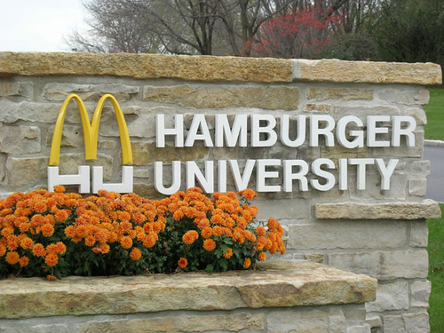
Wanna Franchise a McDonalds? Who Doesn’t?!
Start up cost is anywhere from $1-2 million
40% of which must be paid in cash or other non-borrowed money
You must pay McD’s 4% of your sales, or 4 cents of every dollar.
You must pay rent to McD’s
You must attend Hamburger University

Slide 13
Government Regulation of Competition
Maintaining Economic Competition: Markets work the best when there are lots of buyers and lots of sellers. This fosters competition which is good for consumers.
Monopolies – market controlled by one business. Often results in high prices and low quality products.
- Sherman Anti-trust Act (1890) – banned illegal business combinations and monopolies
- The government has used the Sherman Anti-trust Act several times to prevent a single business owner from controlling prices and products.
JP Morgan’s Northern Securities in 1904
John D. Rockefeller’s Standard Oil in 1911
AT&T in 1974
Microsoft in 2004

Slide 14
Government Regulation of Competition
Natural monopolies – LEGAL: Local utilities like water, electricity, natural gas, cable, etc. – Competition isn’t efficient, so businesses are allowed to be monopolies but are heavily regulated by the govt. to ensure proper market practices.
Oligopolies – market control by a few – LEGAL
- Car manufacturers, oil companies, etc.

Slide 15
Government Regulation of Competition
Mergers – combination of businesses – LEGAL as long as the merger does not create a monopoly. The govt. can prevent a merger that will cause one. (Food Lion in NC)
- Vertical- merge different levels/stages of production.
Ex: Hog farm & trucking company
- Horizontal – merger of “like” companies for efficiency.
Ex: BellSouth/Cingular/SBC/AT&T
- Conglomerates – merger of various businesses for profit
Ex: GE – electricity, insurance, real estate, NBC

Slide 16
Economic Indicators

Slide 17
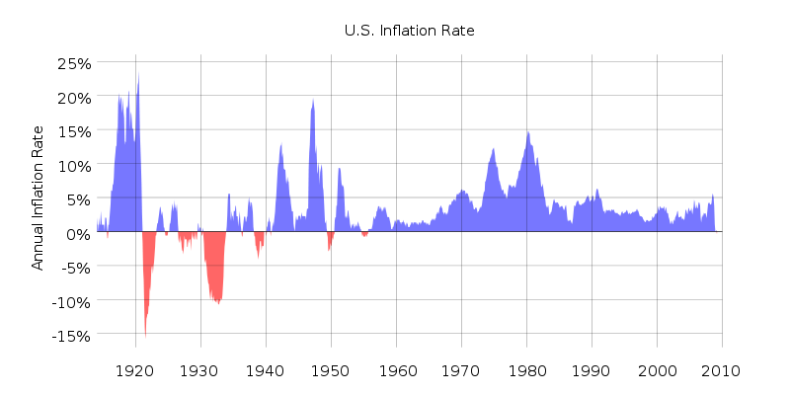
Economic Indicators
1. Inflation: A decline in the value of money
Purchasing power: the amount a dollar can buy

Slide 18
Inflation Purchasing Power 100 years ago…
1915
2015
7 cents
34 cents
25 cents
26 cents
$3-$5
10-15 cents
Loaf of bread
Dozen eggs
Gallon of milk
Pound of steak
Shoes
Movie Tickets
$1.50
$2.11
$3.75
$6-$8
$75-110
US avg of $8.61

Slide 19
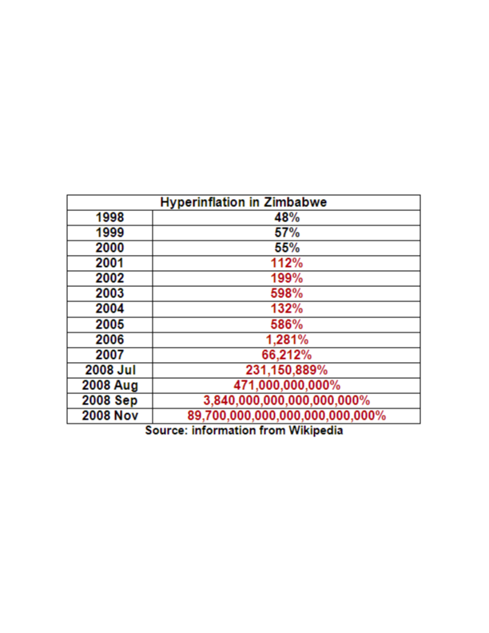
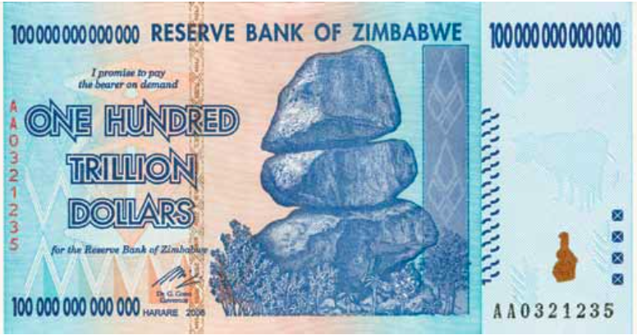
Hyperinflation in Zimbabwe “Where everyone can be a billionaire!”
Once these currencies were ended, the exchange rate was $1 for 35 quadrillion Zimbabwe dollars.

Slide 20
Economic Indicators
2. Consumer Price Index - Change in price over time of a specific group of goods and services the average household uses.
FOOD AND BEVERAGES (breakfast cereal, milk, coffee, chicken, wine, full service meals and snacks);
HOUSING (rent of primary residence, owners' equivalent rent, fuel oil, bedroom furniture);
APPAREL (men's shirts and sweaters, women's dresses, jewelry);
TRANSPORTATION (new vehicles, airline fares, gasoline, motor vehicle insurance);
MEDICAL CARE (prescription drugs and medical supplies, physicians' services, eyeglasses and eye care, hospital services);
RECREATION (televisions, cable television, pets and pet products, sports equipment, admissions);
EDUCATION AND COMMUNICATION (college tuition, postage, telephone services, computer software and accessories);
OTHER GOODS AND SERVICES (tobacco and smoking products, haircuts and other personal services, funeral expenses).

Slide 21
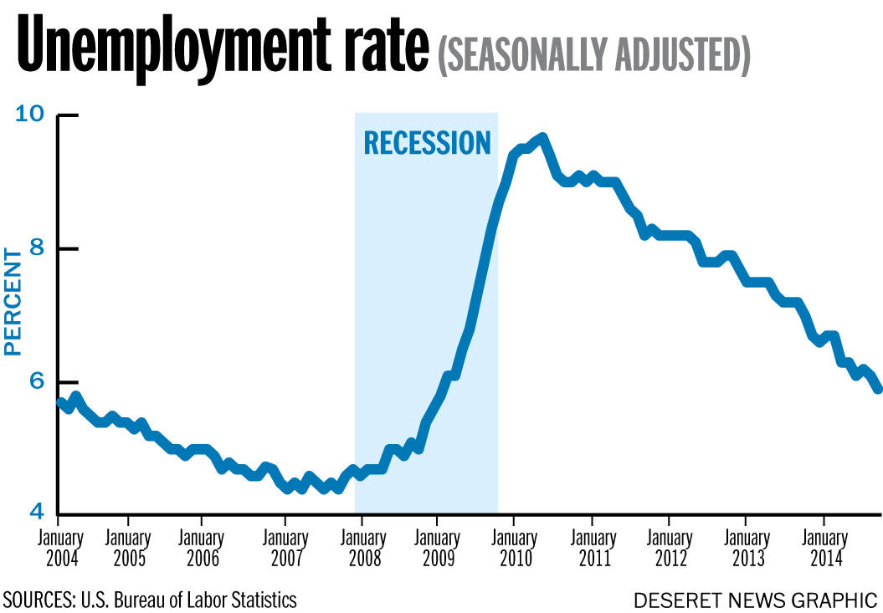
Economic Indicators
3. Unemployment
Unemployment rate: Percentage of the labor force without jobs but actively looking for work.

Slide 22
Unemployment Rate
Currently, the unemployment rate is 5%, down from 10% in October of 2010.
This is still 7.9 million people, but still a pretty low rate.
In 1933, the unemployment rate hit 25%.

Slide 23
Unemployment Types
Cyclical: Associated with the ups and downs of the economy.
Structural: Changes in the economy based on technology.
Seasonal: Based on weather.
Frictional: Based on people being terminated or looking for new jobs.

Slide 24
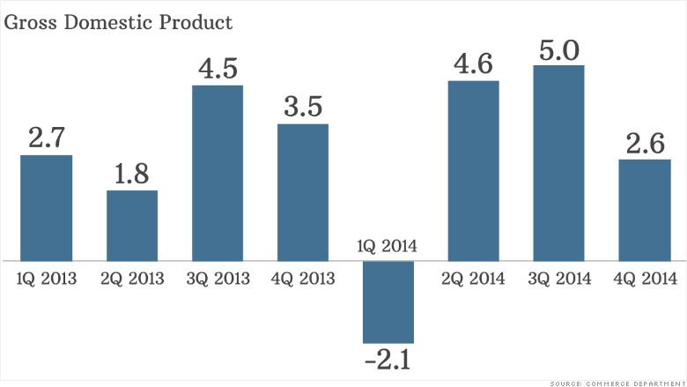
Economic Indicators
4. Gross Domestic Product
The total dollar value of all final goods and services produced and sold in the nation during a single year. Only new goods are counted.
The GDP of the US in 2014 was $17.42 TRILLION

Slide 25
The Business Cycle
Ups and Downs of the Economy

Slide 26
Business Cycle 4 Phases
Prosperity / Expansion
The economy is improving and business activity increases.
Businesses produce more and hire more employees.
Consumers buy more.

Slide 27
Business Cycle
Boom / Peak
Economic activity is at its peak.
Businesses are working at full capacity.
Stores are selling at record amounts.
Peak: Highest point of the Boom cycle.

Slide 28
Business Cycle
Recession
The economy slows down.
Production is cut down.
Workers are laid off.

Slide 29
Business Cycle
Trough
Lowest period for production.
Unemployment is high.
People do not buy as much.
Depression: A severe recession.

Slide 30
Great Depression
The depression begins in 1929, starting with the stock market crash that occurred on October 29, 1929 – this is known as “Black Tuesday.”
The couple years prior to the crash, stock market prices were at their highest.
Over 16 million shares of stock were sold that day.
Banks had invested money into the stock market so when people went to get their money, it was gone!
The average family income fell from $2,300 to $1,600.
1930: 4 million Americans were unemployed. By 1933 the number tripled.
Herbert Hoover was President during the beginning years of the Depression (1928 to 1932).

Slide 31
FDR’s New Deal
FDR’s plan to end the depression. Roosevelt had 3 R’s: Relief, Recovery, and Reform, that were implemented to help the economy.
Began “fireside chats” insuring Americans the situation would improve.
Hundred Days Congress: March 9-June 16, 1933. Congress passed 15 bills. Most were written by FDR.
These bills passed by Congress created public works projects and opened up millions of jobs for the unemployed.
However, he firstly had to restore faith in banks.

Slide 32
Fiscal and Monetary Policy

Slide 33
Financial Reform
Glass-Steagall Act (1933): Banks could not invest in the stock market. Created the FDIC to insure deposits.
Today the FDIC insures deposits up to $250,000
The nations economy would now be split into fiscal and monetary policy.

Slide 34
Fiscal Policy
The way the government taxes and spends money.
In a recession:
The government spends more money on public works projects in order to provide jobs. This keeps companies running and workers employed.
Provides money to people and increases demand. Producers will then increase supply.
Tax cuts: Gives people more money to spend.
During a peak: Government will increase taxes

Slide 35
Monetary Policy
The way the government regulates the amount of money in circulation. The Federal Reserve (FED) is in control of monetary policy.
The Fed Prints new money and destroys old money. 12 branches throughout the US
Banks borrow and send money to the Federal Reserve
The Federal Open Market Committee (FOMC) decides policies about money for the Federal Reserve.
Tight Money Policy
Loose Money Policy

Slide 38
Monetary Policy
The Fed will control money supply depending on how the economy is doing.
1. Raise or lower the discount rate: the rate the Fed charges member banks for loans.
2. Raise or lower reserve requirements: banks must keep a certain percentage of their money in the Federal Reserve. Banks loan out money not in reserve to make their own $$.
3. Open Market Operations: buying and selling US Govt Bonds and Treasury Bills

Slide 39
Monetary Policy
Loose Money Policy (Expansionary)
Tight Money Policy (Contractionary)
Easy to borrow
Consumers buy more
Business expansion
Employment increases
Spending increases
**May lead to inflation
Difficult to borrow
Consumers buy less
No business expansion
Unemployment increases
Production decreases
**May lead to a recession

