Slide 1
The Constitution

Slide 2
The Constitution
Is the supreme law of the land.
Provides the framework for government in the United States.
All powers of each branch of government are in the Constitution.

Slide 3
Constitutional Breakdown
1. Preamble
2. Seven Articles:
I. Legislative Branch
II. Executive Branch
III. Judicial Branch
IV. Relations among states
V. Amending process
VI. National Supremacy (National Supremacy Clause)
VII. Ratification process
3. Twenty-seven amendments

Slide 4
Preamble
The Preamble is the opening of the Constitution that states its purpose.
To form a more perfect union: unification for the good of all states
To establish justice: laws/courts that treat all fairly
To insure domestic tranquility: keep peace and order at home
To provide for the common defense: protect country from outsiders
To promote the general Welfare: prosperous lives for all
To secure the Blessings of Liberty to ourselves and our Posterity: guarantee freedoms for everyone, now and in the future

Slide 5
Principles of the Constitution
There are 6 main ideas behind the structure of the Constitution that are the center for how our government functions.

Slide 6
Principles of the Constitution
Popular sovereignty: the right to rule comes from the people (elections ensure this principle)
Voting best shows the idea of how popular sovereignty works

Slide 7
Principles of the Constitution
Rule of law: laws apply to everyone, even those that govern

Slide 8
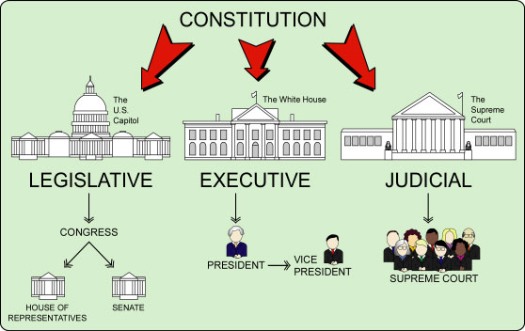
Principles of the Constitution
Separation of powers: government is divided into three branches with each having different functions (legislative makes laws, executive enforces law, judicial interprets laws)

Slide 9
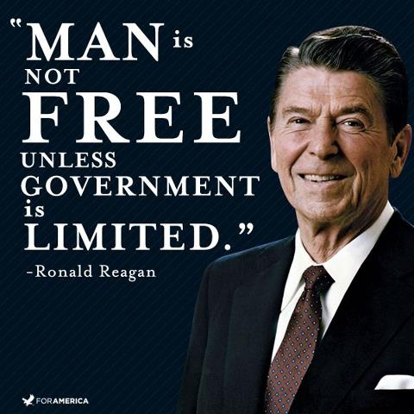
Principles of the Constitution
Limited Government: The Constitution is designed to keep the involvement of the government limited because of guaranteed personal liberties

Slide 10
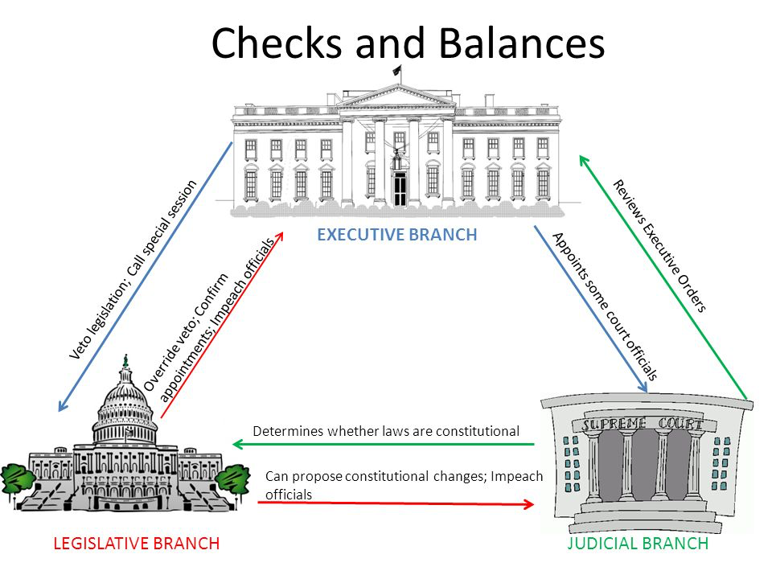
Principles of the Constitution
Checks and balances: the ability of each branch of government to check/restrain the others

Slide 11
Principles of the Constitution
Federalism: nat’l and state govts work together but the Constitution is the supreme law of the land and the national nor state governments can violate it
Expressed powers: enumerated powers only for national government
(Tax, Make $, Declare war, trade, etc…)
Reserved powers: powers given to the states
(education, roads, hospitals, marijuana, etc…)
Concurrent powers: powers shared by both the national and state governments
(taxing, making and enforcing laws, conducting elections, etc…)

Slide 12
Implied Powers
Powers that are found in the “necessary and proper clause” in Article I of the Constitution
Also called the “elastic clause” because it allows Congress to ‘stretch’ their powers.
This allows Congress to make any law they see as necessary that may not be already listed in the Constitution.
Examples: having an income tax, the military draft, minimum wage

Slide 13
7 Articles
Articles: explains how our government works
Article I: Legislative Branch - lawmaking authority (Congress)
Article II: Executive Branch - law-enforcement authority (President and Vice-President)
Article III: Judicial Branch - interpret laws and see they are applied fairly (US Supreme Court and lower courts established by Congress)
Article IV: states – explains how new states will be created, says states must respect each others laws (full faith and credit), and guarantees federal government protection
Article V: amending process for the Constitution
Article VI: says Constitution is the supreme law and state laws may not interfere (National Supremacy Clause)
Article VII: 9 out of 13 states needed to ratify Constitution

Slide 14
Amending Process
Amendments: changes to the Constitution, only 27 times (the first ten are known as the Bill of Rights); purposely difficult to change (two part process)
Proposal: congressional action by 2/3 vote or 2/3 of state legislatures requesting a national convention
Ratification: vote of ¾ of the state legislatures or special convention

Slide 15
Interpretation
Loose interpretation: Congress can make any law that the constitution does not specifically forbid.
Strict interpretation: Congress can only make laws that the constitution gives them direct authority over.
The Supreme Court interprets the constitution and can declare laws unconstitutional.

