Slide 1
Making and Breaking the Law
Know Your Rights!

Slide 2
Origins of Law and Types of Law

Slide 3
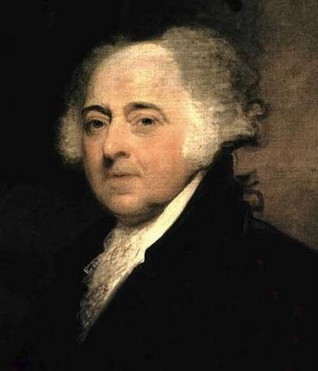
What is Law?
John Adams – “In the United States, we will have a government of laws, not of men.”
Law: a set of rules that allow peaceful living in a society.
- Rule of Law
- Acts as a deterrence

Slide 4
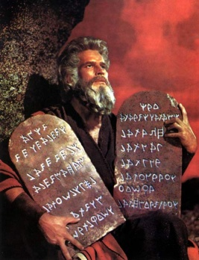
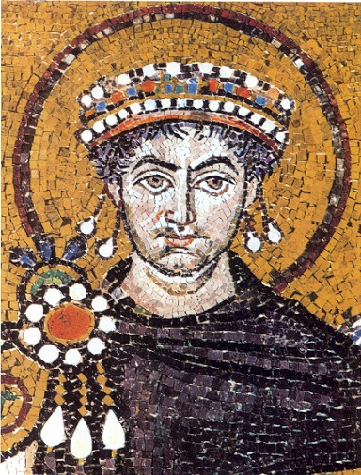
Influences on American Law
Hammurabi’s Code (1750BC):
first written set of laws.
If laws are written and posted for all to see, then everyone has to follow the same laws.
Ten Commandments- (1446 BC)
A list of moral and religious principles
Roman Law:
- Jurisprudence: the study of law.
Code of Justinian (528 AD): Emperor Justinian of Eastern Roman Empire has all existing laws and decrees written down in a single document.

Slide 5
Influences on American Law
Draconian Law- 621 BC
Laws were harsh and included death penalty for minor offenses
Magna Carta- 1215
England’s first document to check the power of the king
Declared people could not be deprived or lives, liberty, or property except by judgment of their peers
Iroquois Nation Constitution- 1500
Established a confederacy of nations amongst Native Americans
First oral/spoken Constitution in the US
English Common Law
Traditions and customs borrowed from England

Slide 6
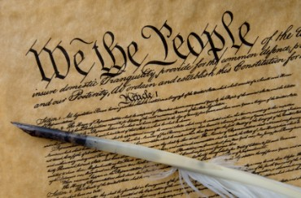
Types of Law
English Common Law: based on traditions and precedent. Not all are written down.
Trial by jury.
Innocent until proven guilty.
Constitutional Law:
Laws from Amendments
Certain rights given to the government and people

Slide 7
Types of Law
Criminal Law: Some type of misdemeanor or felony has been committed
Civil Law: disputes between people (lawsuits)
Tort: a civil case where injury occurs
Family Law: Divorce, custody, child support, adoption.
Administrative Law: laws carried out by executive agencies and regulatory commissions (FDA, CDC, OSHA, IRS)
Statutory Law: laws for states. Ex: speed limits, alcohol laws, food inspection.
International Law: between two or more countries.
The World Court: settles disputes between two or more nations. Also prosecutes war criminals.

Slide 8
Rights of the Accused and Citizen Protections
Know them!

Slide 9
Rights of the Accused/Defense
Before you go and break the law, you may want to understand a few things.
As we’ve discussed, you have certain rights given to you found in the Bill of Rights.
Use them! As they may get you off the hook!

Slide 10
Rights of the Accused/Defense
You are protected from double jeopardy, meaning you can’t be charged twice for the same crime.
You have the right to due process (5th/14th Amendments). This means you have the right to receive fair treatment throughout the entire judicial process.

Slide 11
Rights of the Accused/Defense
Amendment 6 guarantees all of the following:
A lawyer
A speedy and fair trial
An impartial jury
Confronting witnesses
Knowing your accusers and the charges against you

Slide 12
4th Amendment Protections
Probable cause
Protects from an unreasonable search
Exclusionary Rule
May not use illegally obtained evidence
Search Warrant
Needed to search your property
Only issued by a judge
Landmark Supreme Court Cases?
New Jersey v. TLO
Mapp v. Ohio

Slide 13
8th Amendment Protections
No cruel and unusual punishment
No unfair bail, fines or fees

Slide 14
Law Enforcement Agencies
Found at all 3 levels of government, all part of the executive branch; carry out law enforcement
Federal
FBI, OSHA
State
SBI, State troopers
Local
Sheriffs, HSPD

Slide 15
Criminal Law

Slide 16
Criminal Law
Prosecution charges the defendant with a crime.
Certain crimes differ from state to state and are found in each state’s penal code.
Which court has jurisdiction?
What type of crime?
Misdemeanor or felony?
Crimes against people or crimes against property?
Victimless crime?

Slide 17
Steps in a Criminal Case
Arrest suspect
Preliminary hearing: judge hears charges and sets bail
Indictment: a grand jury decides if there is enough evidence for trial
Arraignment: Defendant enters plea: guilty or not. Trial date is set
Or defendant can issue a plea bargain.

Slide 18
Steps in a Criminal Case
Trial takes place
The petit jury decides the verdict
The judge issues the sentencing
The convicted may appeal

Slide 19
The Trial
Both sides gather evidence and question witnesses.
Witnesses receive a subpoena to appear in court
A jury is selected.
Prosecution makes opening statement. Defense makes opening statement.

Slide 20
Trial Continued…
Prosecution calls witnesses for testimony. Defense will cross-examine. Prosecution will then rest.
Defense calls witnesses for testimony. Prosecution will cross-examine. Defense will then rest.
Both sides make closing statements.

Slide 21
Jury Decision
Standard of evidence is “beyond a reasonable doubt” – jury must be 100% sure
Acquittal: The jury decides not guilty. Defendant is released.
Convicted: If the jury decides a person is guilty, the judge will then set a date for sentencing.
Hung jury: A jury cannot make a decision. This is a mistrial.

Slide 22
Sentencing
Four functions: Punishment, social protection, deterrence, and rehabilitation.
Some prisoners are eligible for parole after serving part of their sentence.
Indeterminate sentence: Judge sets a minimum and maximum sentence.
Determinate sentence: Judge sets a specific sentence.
Mandatory sentence: Judge sets a sentence in accordance with state laws.

Slide 23
Incarceration/Recidivism/Juvenile Courts

Slide 24
Incarceration and Recidivism
Incarcerated – imprisoned
The US has the highest incarceration rate in the WORLD
Many more males than females
Recidivism – returning to prison after serving jail time
Correlation with age: the older a person gets, the odds of experiencing recidivism decline

Slide 25
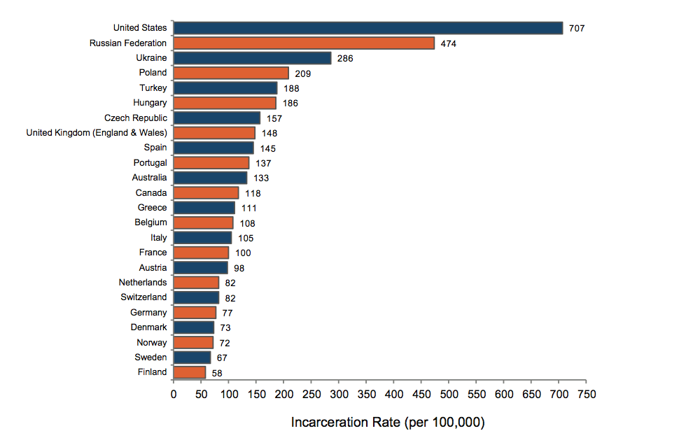

Slide 26
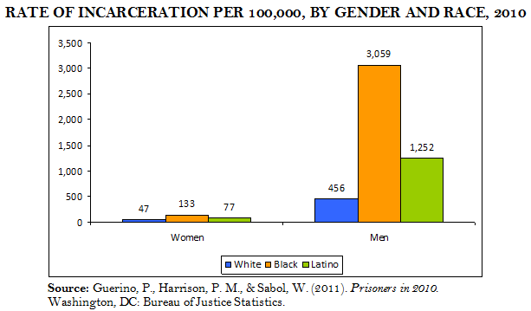

Slide 27
Juvenile Courts
A juvenile is anyone under the set age for an adult in a specific state.
A juvenile DELINQUENT is a juvenile who has committed a crime
You are an adult in NC at 18 HOWEVER……
NC is 1 of 2 states that will charge 16 and 17 year olds as adults
The “age of consent” in NC is 16.

Slide 28
Juvenile Courts
The goal is rehabilitation, not punishment
Neglect cases: Children who are neglected or abused by caregivers.
Delinquent cases: Children who commit crimes.
At a delinquent court appearance, the child, parents, arresting officer, probation officer, lawyer, and judge meet.
No jury trial. The judge decides delinquent or non-delinquent.

Slide 29
Juvenile Rights and Protections
Parents must be notified of arrest. Charges must be written down.
Juveniles are not fingerprinted or photographed.
Right to confront witnesses.
Identity is kept secret. Records can be erased as adults.
Right to remain silent and have an attorney.
Most of these protections were established by the Supreme Court (In re Gault case).

Slide 30
Punishment for Juveniles
Lectured, placed in special schools, or probation.
Ward of the court: Court may become guardian.
Sometimes tried as adults.

Slide 31
Civil Law

Slide 32
Civil Law
In civil law, a harmed individual (plaintiff) seeks to win a judgment against the accused wrongdoer (defendant).
A summons is sent to the defendant requiring them to appear in court, and they enter a plea.
Often times these cases are settled outside of court
*** The same illegal activity can be a crime & tort! ***

Slide 33
Civil Law
Civil law includes tort law.
A tort occurs when one person causes injury to another person or to another persons property or reputation.
Civil law may also include divorces and child custody cases

Slide 34
Civil Law
The question to be answered is over liability – who is responsible for the harm?
May be decided by a lone judge, or the plaintiff my request a jury if the amount involved is over $20 (7th Amendment!)
Standard of evidence here is “preponderance of evidence” – judge/jury only needs to be 51% sure

Slide 35
Civil Law
Punishment is not jail time, but rather restitution, or monetary payment
Damages may be awarded by the jury, including:
Compensatory Damages - recover damages to make up for the harm caused.
Nominal Damages – small amount of money awarded by the courts to show that the claim was justified.
Punitive Damages – amounts of money awarded to the plaintiff to punish the defendants for malicious, willful, or outrageous acts.

