Slide 1
The Legislative Branch
How does the most powerful branch of government work to represent citizens at each level of government?

Slide 2
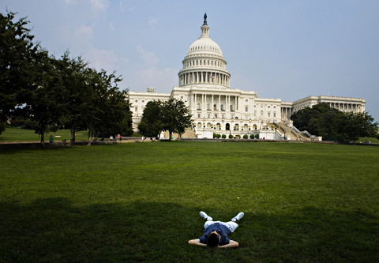
Congress
The Legislative Branch of our government is led by Congress.
They meet in sessions each year from January to November.
Usually, the two houses of Congress meet separately, but they occasionally meet together in a Joint Session.

Slide 3
The House of Representatives
435 members; must be 25 and a 7 year US citizen. Each representative serves for two years
Representation is based on population. The number of representatives of each state changes every ten years based on the census. This process is called apportionment.

Slide 4
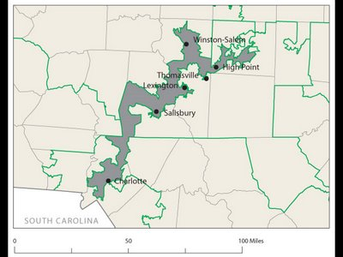
Congressional Districts
Each state is divided in parts of approximately equal population called districts. There is one representative per district. The people living in each district are called constituents.
Gerrymandering: drawing a district to favor one group over another. This is illegal. NC is one of the most gerrymandered states in the US.
Representatives focus on the concerns of their district rather than the whole state.

Slide 5
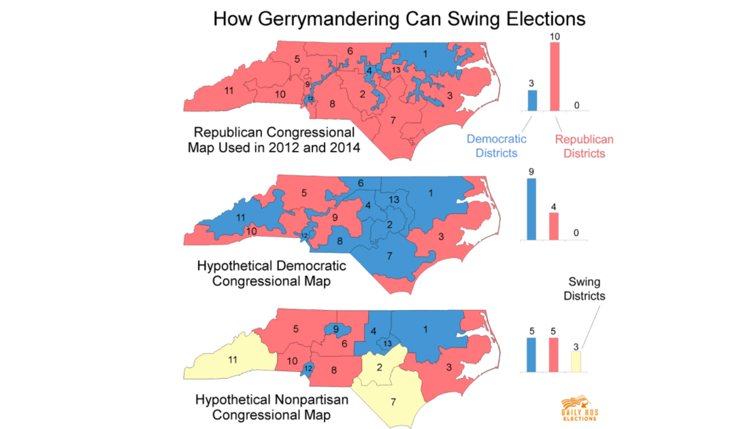

Slide 6
The US Senate
100 members; must be 30 and a 9 year US citizen. Each senator serves a six year term.
Each state has 2 senators who represent the entire state.
1/3 of senators are up for re-election every two years, so there is more consistency in the Senate.

Slide 7
Congressional Leaders
Each house of Congress has a majority party (>50%) and a minority party (<50%).
The majority party in the House of Representatives elects the Speaker of the House. This is the most powerful single person in the Congress.
Powers of the Speaker:
1. Choose which bills to address
2. Choose who will speak
3. Choose when to vote
Paul Ryan – Speaker of the House

Slide 8
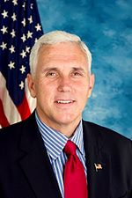
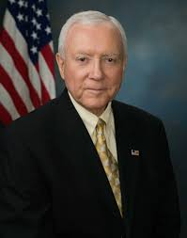
More Leaders
The Vice President is the official leader of the Senate. He is rarely there and only gets to vote to break a tie. The day to day leader of the Senate is called the President Pro Tempore.
Each house has party leaders called the majority or minority leader. They direct members of their party to act on certain bills.
Each party also has officials called “Party Whips” who make sure members of the party are doing what has been asked of them.
Mike Pence
Vice President
Orrin Hatch
President Pro Tempore

Slide 9
Congressional Committees
Most real work of the Congress happens in committees.
Types of Committees:
1. Standing: permanent; work on issues that never go away
2. Select: temporary; once they finish, the committee disbands
3. Joint: members of both HOUSES (HoR and S)
4. Conference: members of both PARTIES (D&R) work together to finalize a version of a bill
The leader of each committee is called the “Chair” and is always the most senior, or experienced, member.
https://www.govtrack.us/congress/committees/

Slide 10
Special Powers of Congress
House of Reps
Senate
Elects Pres if no majority
Appropriations bills (dealing with money/taxes)
Accusations of impeachment
Ratifies treaties
Elects VP if no majority
Impeachment trials
Approves Pres. appointments

Slide 11
Limits on Congressional Power
Cannot violate individual liberties
Cannot suspend the Writ of Habeas Corpus: cannot put people in jail without a charge
Cannot pass a Bill of Attainder: cannot put someone in prison unless convicted in a trial
No Ex Post Facto Laws: cannot charge someone with a crime if they committed the act before it was a crime

Slide 12
Benefits of Congress
$150,000 annual salary
Free trips to home state
Franking Privilege: send work related US mail for free
Each member of Congress has close to 100 staff members who assist in many ways. They gather information on new bills, deal with lobbyists and the press, and deal with letters/email from constituents.
Immunity from minor crimes
Discounts on services.

Slide 13
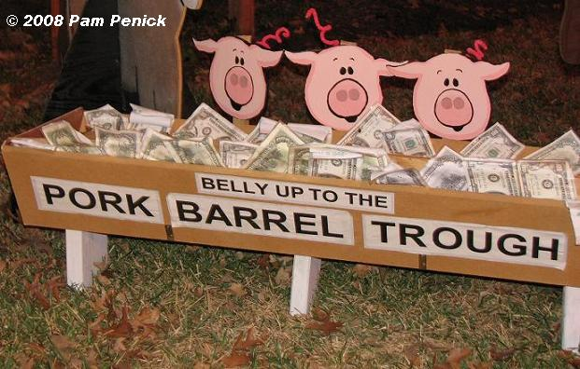
The Three Jobs of Congress Members
1. Lawmaking
2. Casework: help constituents (voters) deal with the Federal government
3. Helping the district/state: get Federal money for projects at home. These are called “pork-barrel” projects. Sometimes wasteful such as the “Bridge to Nowhere”

Slide 14
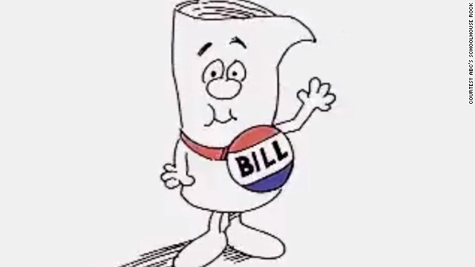
How a Bill Becomes a Law
1. A bill starts out as an idea (anyone can have this idea).
2. The idea is then proposed in either house of Congress (only by a member of Congress)
3. The bill is moved to a committee depending on its topic.
4. The committee can do one of four things:
a. Research and approve
b. Pigeonhole it (set it aside)
c. Reject it
d. Change it

Slide 15
Bill to Law Continued
5. Once approved in committee, it goes to either the House or Senate for debate.
a. The House limits how long someone can debate the bill
Senators may conduct a filibuster (talk it to death)
A cloture must be passed to limit how long a Senator may talk (3/5 vote)
6. Once passed with a simple majority in one house (half plus one), it moves to the other house. (H>S, or S>H)
7. Bill goes to a conference committee if necessary to finalize it.
8. Once it’s passed with a simple majority in both houses, it goes to the President.

Slide 16
Presidential Action
9. Once the President gets the bill, he can do one of three things:
a. Pass the bill into law
b. Veto (reject it)
c. Pocket Veto (set the bill aside for 10 days)
10. If the bill is vetoed, Congress can override the veto with a 2/3 vote from both houses.

