Slide 1
The Executive Branch
National, State and Local

Slide 2
US Executive Branch
Led by the President of the United States.
All presidents have been white males, except for Obama. All but one has been Protestant.
Cabinet: Group of advisors to the president.

Slide 3
Qualifications
Must be a native-born US citizen.
Must be 35 years old.
Must have lived in the United States for 14 years.
The president is elected every four years by the Electoral College.

Slide 4
Presidential Amendments
22nd Amendment
President can serve a max of two terms, or ten years.
Amendment was put in place when FDR served FOUR terms.
25th amendment
VP takes over if the president can not fulfill his duties for any reason.
The presidential line of succession provides a lay out of who would be president in many cases.

Slide 5
The Vice President
Vice President
Same qualifications as the President.
Leader of the Senate, votes only in case of a tie.
Becomes President if the President dies.
William Henry Harrison was the first President to die in office, and his VP, John Tyler finished out his term.

Slide 6
Foreign v. Domestic Policy
The President carries out laws passed by Congress and his own beliefs through foreign and domestic policy.
Foreign policy is a nations plan for dealing with other nations
Domestic policy includes policies and programs that deal with issues within the country.

Slide 7
Obama’s Domestic and Foreign Policies
Foreign
Domestic
End war in Iraq responsibly
Finish fight against terrorists in Afghanistan
Secure nuclear weapons from terrorists
Work with Iran on numerous issues
Fight global poverty
Ensure a strong US-Israel relationship
Lifted sanctions against Cuba
Less reliance on foreign oil, more reliance on new energies
Education reforms
Healthcare (Obamacare)
Economic recovery
Immigration policies

Slide 9
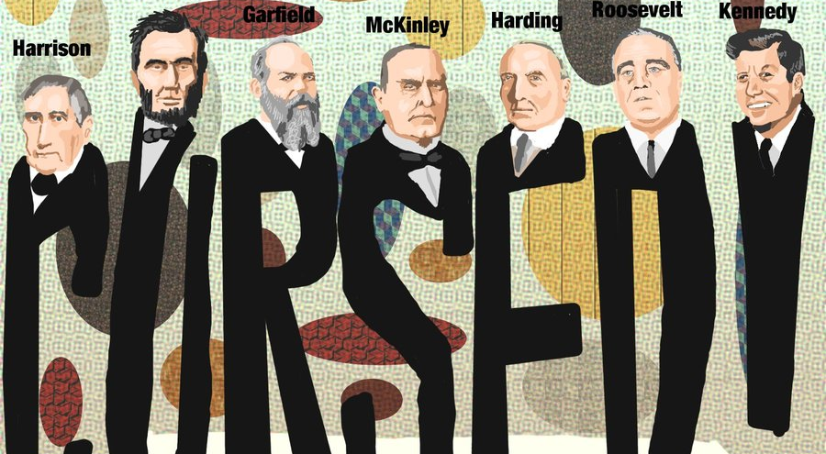
The Curse of Tippecanoe / The Zero Year Curse

Slide 10
Presidential Roles
Chief Executive
The president can issue executive orders, a command that has the force of law.
The president appoints many officials which must be approved by the Senate.
Can issue a pardon - forgiveness and freedom from a punishment.
Can issue amnesty - a pardon for a group of people.
Can issue a reprieve - delay of punishment.

Slide 11
Presidential Roles
Chief Diplomat
Appoints ambassadors and makes treaties.
Ambassador: Official representative to a country.
Treaty: Agreement between two or more countries. Must be approved by the Senate by a 2/3 majority.
Executive Agreement: Agreement between the president and the leader of another country. Does not require Senate approval.

Slide 12
Presidential Roles
Commander in Chief
Congress is given the power to maintain an army and declare war. Only the President can order troops into battle.
War Powers Act (1973): The president must inform Congress when troops are sent into battle. Troops must be brought home after 60 days unless Congress grants an extension.
The president can order troops to stop disturbances in the United States during peace time.

Slide 13
Presidential Roles
Legislative leader
Presidents must have the support of congress.
The president can write a bill, but someone from Congress must introduce the legislation.
The president tries to make deals with Congress.
The President tries to gain support from the American people through the use of the mass media.

Slide 14
Presidential Roles
Party leader
The president helps other party members get elected (coattail effect).
Appoints people with his views.
Economic Leader
Deals with problems of the economy like unemployment, rising prices, high taxes.
Plans the federal government’s budget.
Chief of State
The president represents the entire nation.
Acts as the symbolic leader of the United States.
People are very interested in the president and his family.

Slide 15
Executive Office of the President (EOP)
Executive Office of the President: the Presidents administration who carry out a wide range of jobs
White House Office (President’s closest advisors, the most important is the chief of staff)
Office of Management and Budget (OMB, prepares budget and monitors federal spending)
National Security Council (NSC, helps President with military issues and foreign policy, supervises the CIA)
Office of Administration (administrative services);
Council of Economic Advisors (CEA, gives President information on the economy)

Slide 16
Federal Bureaucracy
Federal Bureaucracy
The network of agencies and departments of the government.
Lots of “red tape”: Inefficiency caused by rules and regulations.
Each person has a designed function and must operate within a chain of command.
People must be well-trained and managed.

Slide 17
Executive Departments
There are currently 15 depts.
The most recent of which is the Dept. of Homeland Security
The head of each is led by a Secretary, appointed by the Pres and approved by the Senate
These 15 secretaries make up part of the President’s cabinet.
The cabinet is there to advise the President

Slide 18
Independent Agencies
The President appoints the heads of these agencies with Senate approval
Executive Agencies – deal with specialized areas
IRS, FBI, FEMA
Government Corporations
US Postal Service
Regulatory Boards/Commissions - protect the public by making rules for certain groups or industries
FTC, FDA, FCC, EPA

Slide 19
Government Workers
Top jobs like Cabinet Secretaries are appointed by the President with Senate approval and leave their office when a new President is elected;
Other jobs are hired through the civil service system which is based on exams, experience or merit and their job is permanent, or until they quit.
Before the Civil Service Reform Act of 1883 federal jobs were given as a reward to those who had given political support to the elected President which was also called the spoils system.

