Slide 1
Elections
What is the easiest way for citizens to influence the government?

Slide 2
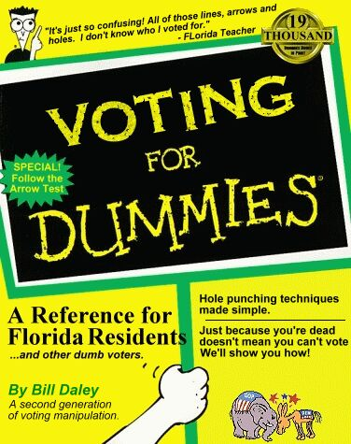
Who Can Vote?
18 years old, not in prison, registered.
Some convicted felons lose the right to vote forever. In NC, felons can vote when they have completed their sentences.
You can register at libraries, schools, and county election offices, the DMV.

Slide 3
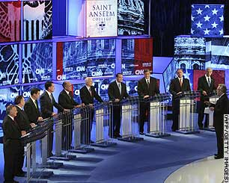
Presidential Election Process
1. Nominating Conventions: Delegates are nominated.
2. Caucuses and Primaries:
Caucuses: Citizens meet at a public gathering and ‘openly’ vote for their preferred candidate. (Video Link)
Primary elections: Registered voters privately vote for their candidate.
Open: Party membership not required to vote.
Closed: Only registered party members may vote.

Slide 4
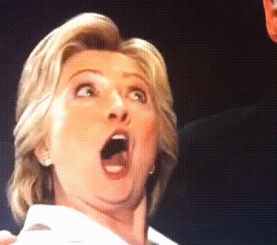
Presidential Election Process
3. Debates/Campaign
4. The candidate for each party is announced at the National Convention.
Essentially, it’s a big celebration for their candidate.
The chosen candidate chooses a running mate for VP. (Ticket)
5. General Election – people vote
6. Electoral College vote

Slide 5
Political Campaigns and Propaganda

Slide 6
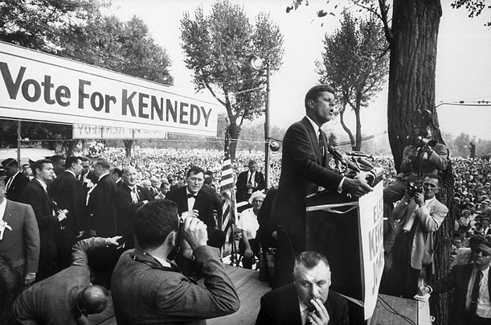
Campaigns
Over $4 billion are spent every four years on political campaigns.
Canvassing: people go door to door to promote a candidate or take a poll.
Advertising and Image Molding: candidates use many techniques to convince potential voters of what type of person they are.

Slide 7
Financing Campaigns
Political Action Committees (PACs): Fund raising organizations.
Presidential Election Campaign Fund: Tax payers check a box on tax forms.
Elaborate dinners are held to raise money.
Individuals contribute money.

Slide 8
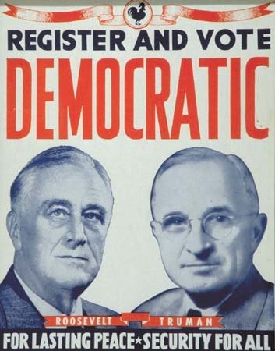
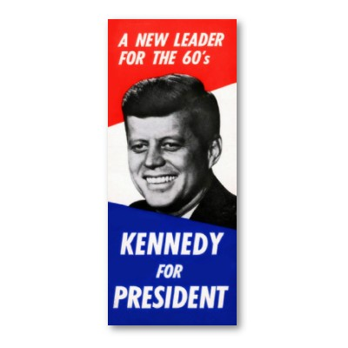
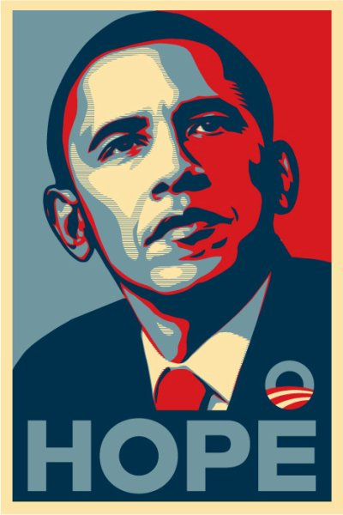
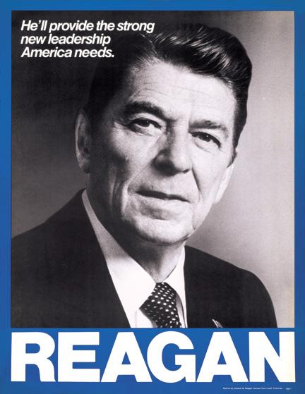
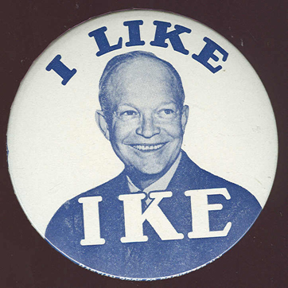
Presidential Campaign Posters

Slide 9
Propaganda
Information and ideas deliberately spread in order to affect peoples opinion of a person, group, or issue.
Types:
- Print: Posters, magazines, mailings, etc.
- Radio: Audio only ads played on the radio.
- Video: commercials and other informational programs played on TV or the Internet.

Slide 10
Propaganda Techniques
Glittering Generality: Use attractive, but vague words that make speeches and other communications sound good, but in practice say nothing in particular.
Plain Folks: Make the leaders look just like mom'n'pop-style ‘plain folks’.
Bandwagon: Make it appear that many people have joined the cause already, and that they are having lots of fun or getting significant advantage.
Endorsements: celebrities and public officials publicly support a candidate.

Slide 11
More Techniques
Card-Stacking: Candidate lists accomplishments and statistics showing their capabilities.
Name-Calling: Information is presented to intentionally discredit the opponent or the ideas of an opponent.
Transfer/Symbol: Candidate is shown with common symbols of America (flags, eagles, Statue of Liberty, etc.). Designed to make candidate look patriotic.

Slide 12
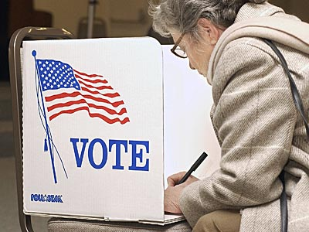
Voting Process
Each county is divided into pieces of equal population called precincts (voting district). Registered voters are assigned a precinct with a polling place based on where they live.
Straight ticket: vote for the same party in each race.
Split ticket: vote for different parties on same ballot.

Slide 13
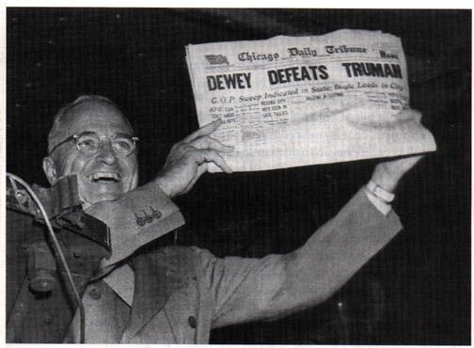
Process continued…
If you can’t make it to the polls on election day, you fill out an absentee ballot
Many media outlets guess (called making a projection) on who has won a race based on a percentage of the votes.
Those not interested in voting are considered to have voter apathy.

Slide 14
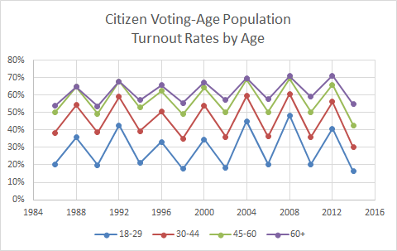

Slide 15
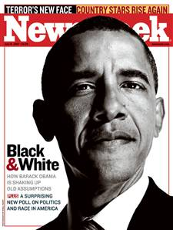
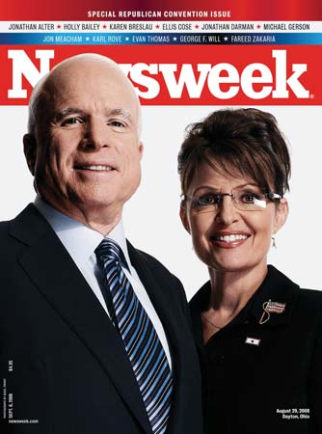
Who to Vote For?
Stay informed! Use trustworthy and unbiased info! Questions to consider:
1. Does the candidate share your same views?
2. Is the candidate reliable?
3. Is the candidate experienced?
4. Will the candidate be effective?
5. Does the candidate have a chance to win?

Slide 16
Types of Elections
General elections: people vote. Always takes place on the first Tuesday after the first Monday of November in even years.
Who is elected?
Pres. every four years
All members of House and 1/3 of Senators every two years; several members of State and Local government.
Issue Elections: decide government issues
Initiative: voters decide to support or reject a new law.
Referendum: voters can decide to overturn an existing law

Slide 17
Interest Groups
Interest group: People who share a similar point of view.
Strength in numbers – they use this to influence lawmakers
Bring issues to the public and lawmakers.
Support candidates who favor their goals..
Often biased

Slide 18
Types of Interest Groups
The most common type are economic groups.
Business Organizations: Ex:: Natl Assoc of Manufacturers
Industrial and trade: Ex: United Auto Workers
Labor unions: Rights of workers.
Professional associations: Ex: Teachers and doctors
There are groups for ethnic, age and gender.
There are groups that focus on specific causes.
NRA, NAACP, NOW

Slide 19
Lobbyists
Lobbyists often work for interest groups - they try and gain support and influence lawmakers.
Spend a lot of time researching issues in order to persuade (and pressure) lawmakers. They are frequently invited to speak in congressional committees.

