Slide 1
The United States Court System
Essential Questions: What are the similarities and differences between the US and NC courts in terms of structure, power, and organization? What relationship exists between citizens and the government? What relationship exists between the federal, state, and local governments?

Slide 2
US Courts
Hear federal cases with either original or appellate jurisdiction
Most directly influenced by English common law based on precedents.
Decisions made from a previous ruling.
Courts use the idea of judicial review
Reviewing decisions or actions made by the other 2 branches

Slide 3
Marbury v. Madison
John Adams (Pres. #2) appointed several midnight judges throughout the country on his last night as President.
James Madison - Jefferson’s (Pres #3) Secretary of State, was instructed to withhold the commissions (getting assigned the job)
William Marbury and others (one of the midnight judges) sued Madison and took case right to Supreme Court.
The Judiciary Act of 1789 said that the SC could issue a writ of mandamus to force the commissions to be delivered.
SC chief justice John Marshall decided that even though Marbury was entitled to the job, he could not force Madison to deliver the commission and declared the Judiciary Act unconstitutional.

Slide 4
Marbury v. Madison Principles
This case established judicial review and strengthened the power of the Supreme Court and their ability to check the other branches.
Strengthened Article 6 in the Constitution because the Constitution supersedes Judiciary Act

Slide 5
Types of jurisdiction
Jurisdiction - a territory; the power to make decisions
Original jurisdiction – the first court to hear a case
Appellate jurisdiction – the court can review a case heard at a lower court to check for errors
Concurring jurisdiction – when more than one court has the authority to hear a case
Exclusive jurisdiction – when only one court can hear a case

Slide 6
US Court hierarchy
The lowest court in the Unites States District Court.
Above the District Courts are the US Court of Appeals
The highest court in the United States is the US Supreme Court.
US Supreme Court
US Court of Appeals
US District Court

Slide 7
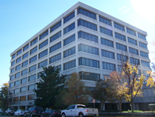
US District Courts
94 US District Courts across the US.
Hears cases from that happen in their district.
Only US court where actual “trials” are held.
Created by the Judiciary Act of 1789.

Slide 8
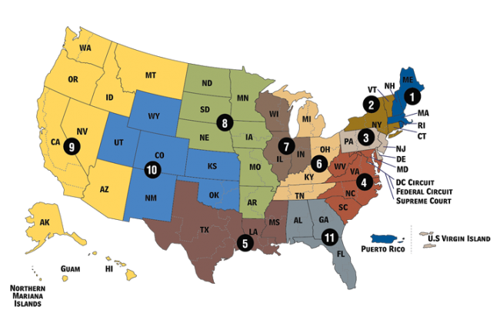
US Court of Appeals
If a case is appealed – or if one of the parties ask for the case to be reviewed, it will be heard at the US Court of Appeals.
This is called Appellate Jurisdiction.
There are 13 US Court of Appeals around the United States known as circuits.
Created by the Judiciary Act of 1789.

Slide 9
Us court of appeals
Each appeals court has from 6-27 judges. A panel of 3 judges will hear each case.
The court may:
1. Uphold the earlier ruling.
2. Overturn the decision.
3. Remand the case to a lower court for a new ruling.

Slide 10
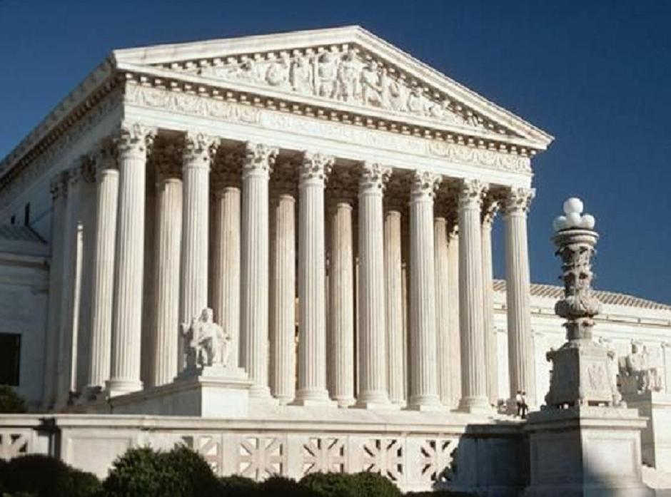
US Supreme Court
The highest court in the United States
Established by Article 3 of the Constitution
Any case appealed from the US Court of Appeals is heard here (Appellate Jurisdiction).
Exclusive/Original Jurisdiction in: cases between the US and a state, state vs state, cases involving foreign diplomats

Slide 11
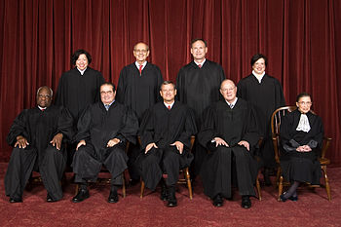
US Supreme Court
Structure of the SC
There are 9 judges– 1 Chief Justice and 8 Associate Justices
Appointed by the President and approved by the Senate
No listed qualifications
Appointed for life – only way to “quit” is to be impeached, die, or resign
Should not be “partisan”

Slide 12
Supreme Court Schedule
People petition for a writ of certiorari, a request for the Supreme Court to hear your case.
First 2 weeks of the month - hear arguments, discuss cases, read briefs (arguments written by attorneys) and vote.
4 out of 9 judges must vote to hear a case.
The case is then placed on the court docket, or calendar.
The case must have 2 opposing sides, or adversaries
Next 2 weeks - they listen to cases and write opinions on other cases.

Slide 13
When making a decision…
When the US Supreme Court rules in a case, we call it the court’s “opinion”.
Majority opinion. (more than half agree)
If a justice disagrees with the majority of the court, they write a dissenting opinion.
If a justice agrees with the majority, but for different reasons, they write a concurring opinion.
If all of the justices agree – it’s called a “unanimous” decision.

