Slide 1
Settling Disputes

Slide 2
4 Methods
Negotiation
Mediation
Arbitration
Court Action

Slide 3
Formality
Court Action
-Less formal
-Just the disputants settle things
-Not legally binding
-More formal
-Many people involved
-Enforceable by courts

Slide 4
Negotiation
Process by which people involved in a dispute discuss their problem and try to reach a solution acceptable to all
Disagreements w/ parents, friends, teachers, etc
Informal
You may hire an attorney to negotiate for you
However, YOU must approve any agreement before it is finalized

Slide 5
5 Steps to Negotiation
1 | Agree to negotiate with an open mind
2 | Identify the problem
3 | Acknowledge competing interests
4 | Evaluate options
5 | Form a workable solution

Slide 7
Bro, you can’t wear white after labor day
Tom
David

Slide 8
Mediation
Process by which a third person helps disputing parties talk about problems and settle their differences
CANNOT impose a decision on the parties
Mediator is neutral
Mediation is voluntary
Disputants themselves must reach agreement
Somewhat formal

Slide 9
Gabby
Mediator #1
Mediator #2
Jalyn

Slide 10
Mediator
Ryan
Ed

Slide 11
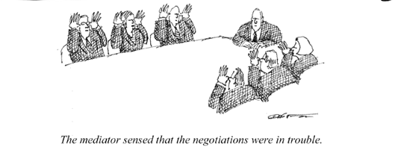
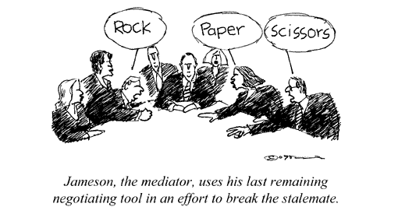

Slide 12
Arbitration
Process by which both parties to a dispute agree to have one or more persons listen to their arguments and make a decision for them
Arbitrators, like judges, have authority to make final decision
Both parties MUST abide by terms of agreement
Common in contract and labor-management disputes
Very formal

Slide 13
Arbitrator #1
Susan
Fred
Arbitrator #2

Slide 14
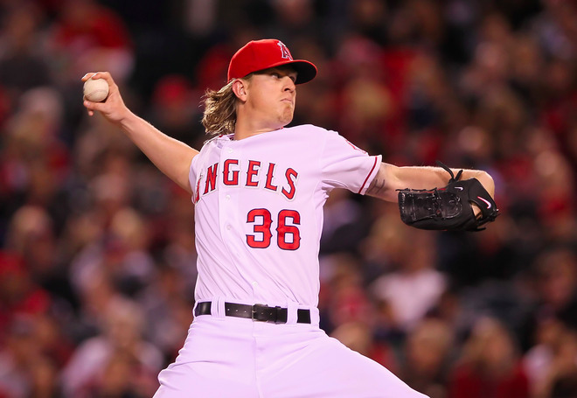
History suggests that players who lose arbitration hearings don’t stay with the teams that defeated them for long, but Jared Weaver has “no hard feelings” after a three-person panel sided with the Angels last week.
Weaver requested $8.8 million while the Angels countered at $7.365 million and the team came out on top after what Mike DiGiovanna of the Los Angeles Times reports was a four-hour hearing.
However, the 28-year-old right-hander doesn’t sound very optimistic about the chances of a long-term contract extension.

Slide 15
Conflict Unsettled Conflict Settled
Loss of friendship or professional business standard
Time consuming
Mentally exhausting
Occasional violence
Costs money
Court action
Retain friendship or at least civility
Time saved
Compromise
Cheaper
Settlement on own terms

Slide 16
Court Action
Discussed later in this course…

