Slide 1
State and Local Govt
3 Branches

Slide 2
Legislative
NC General Assembly and Holly Springs City Council

Slide 3
The NC Constitution
Includes a Preamble and 14 Articles.
Article 1 – Declaration of Rights (equality, pop. sov.)
Articles 2-4: 3 branches
Article 7: Local gov’ts
Article 9: Education (which is not found in the US Constitution)
No Amendments b/c the process is different than the US Constitution
Same principles as the US Constitution

Slide 4
NC General Assembly
Passes laws (called statutes) for the state.
NC Senate: 50 members
Must be 25 and 2 year citizen of NC
NC House of Representatives: 120 members
Must be 21 and 1 year NC resident
The state is divided into 120 House districts and 50 Senate districts.
Sessions: when legislators are working in Raleigh
“Long Session”: in odd years, members meet from Jan-July
“Short Session”: in even years, members meet from May-Aug
Lt. Governor presides over the Gen. Assembly (similar to the VP overseeing the Senate)

Slide 5
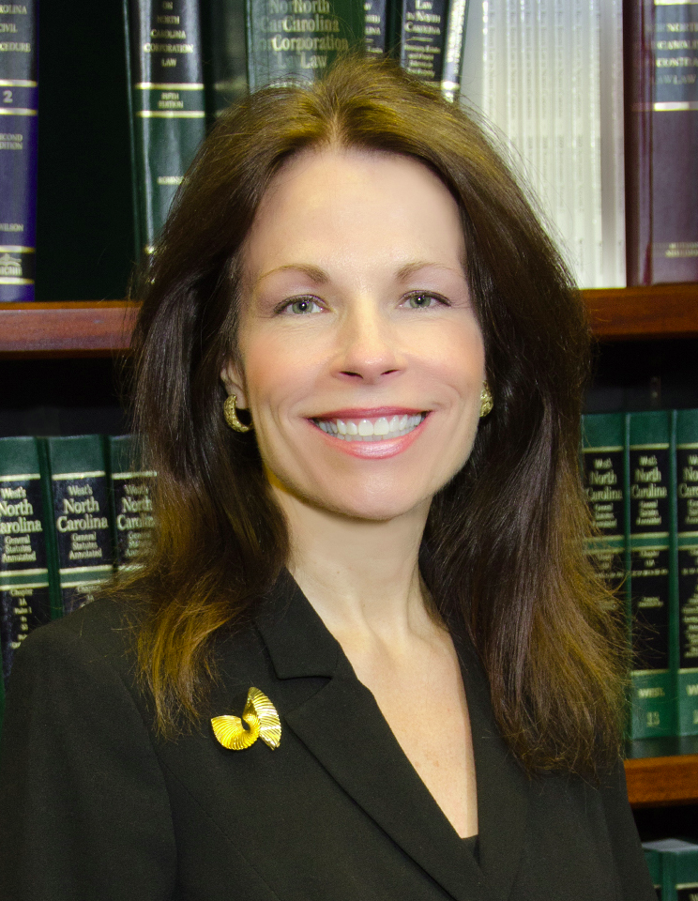
NC General Assembly – Who Represents Holly Springs?
State Rep. Linda Hunt-Williams
Republican
Attorney
State Senator Tamara Barringer
Republican
Asst. Clinical Prof. of Legal Studies

Slide 6
Strange NC bills/laws
Bill H858 – George Washington Bill
Placing a portrait of George Washington in every school. Cost is
is $1mil and funds would be used from the state lottery.
The opossum bill
Potential law that It would suspend wildlife laws from protecting opossums from Dec. 29 to Jan. 2 every year.
From dumblaws.com:
It is a felony to steal more than $1000 of grease
Elephants may not be used to plow cotton fields.
It’s against the law to sing off key.
Serving alcohol at a bingo game is not allowed.
All couples staying overnight in a hotel must have a room with double beds that are at least two feet apart.

Slide 7
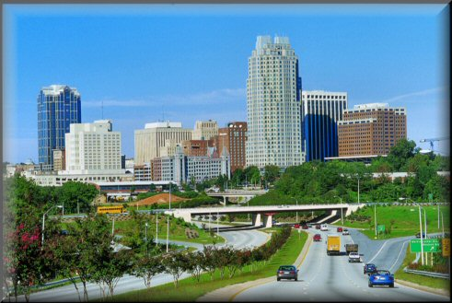
Municipalities
Municipalities: cities, towns, and villages
Provide local services like street lights, water and sewer service, trash pick up.
Incorporated (established) by the General Assembly: the GA approves the geographic boundaries and charter of the city.
A charter is a written document outlining the government of a municipality.

Slide 8
Government in Municipalities
Governed by a city/town council, board of commissioners, or board of aldermen – which make laws for the municipality called ordinances (local laws)
- The council is led by a mayor who may be appointed or elected.
- The board hires a city manager to run the day to day activities of the municipality and enforce the ordinances. The city manager is the Chief Executive of the municipality
Municipalities can expand by annexing land (adding or absorbing a new area)
Municipalities also require zoning (an assignment of land for specific property purposes)

Slide 9
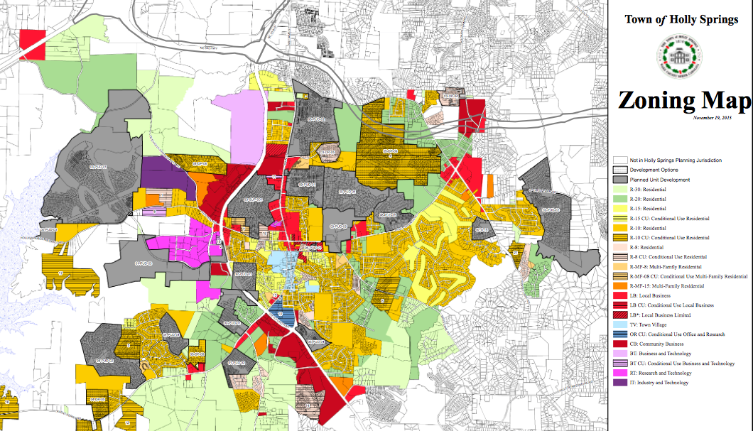

Slide 10
Holly Spring Local Ordinances
You can’t maintain, keep, house, possess, or have under their control within the town any swine, any venomous reptile or any other wild or exotic animal.
“Fighting Words” Ordinance – No loud, profane, vulgar or boisterous language likely to cause an immediate breach of the peace upon the streets, sidewalks, alleys or other public places of the town.
You can’t beg on any street or in any public building unless you get a permit.
You can’t smoke in any town park, park property, greenway, or any area held for public recreation in the town.
You can’t assemble on a sidewalk or street where you would be obstructing the free flow of traffic, and MUST move if an officer asks you to do so.
There is no curfew unless Holly Springs declares one because of a prior disturbance. “Nighttime” is considered to be from 11-7 and applies when discussing laws about disturbing the peace at night (i.e. parties).

Slide 11
NC Counties
General Info:
Exactly 100 counties in NC.
Counties enforce the statutes passed by the General Assembly.
Provide services like public libraries.
Government in counties:
Ran by an elected board of county commissioners.
Oversee elections, alcohol distribution, and schools in the county.
Each county has a Local Education Authority (LEA), aka School Board.
The citizens of the county also elect a sheriff whose jurisdiction is the county.

Slide 12
Citizen Involvement
Citizens may be actively involved in the lawmaking process in one of three ways:
Initiative: a procedure where citizens can propose/vote on new laws or new amendments
Referendum: a way for citizens to vote on state or local laws from the governing body
Bond issues: potential money to be used on various projects (typically schools)

Slide 13
Legislative Branch Summary
 | National | State | County | City
Main job | Make laws | Make laws | Make laws | Make laws
Led by | Congress | General Assembly | County commissioners | City Council
Qualifications | HoR – 25, 7 yrUS citizen, live in district Sen – 30, 9 yr US citizen, live in state | HoR – 21, 1 yr NC citizen Sen – 25, 2 yr NC citizen | Set by county | Set by city
Powers | Impeachment Make money Declare war Appropriations Bills | Set up local govt’s Provide right to education | Carry out statutes from state; provide local services | Provide local services
Structure | House of Reps and Senate | House of Reps and Senate | 100 counties | Mayor-Council or Manager-Council or Commission
Applying Terms | Statutes Apportionment | Statutes Apportionment Gerrymandering | Statutes Sheriff County Commissioners | Statutes Ordinances Annexation Zoning

Slide 14
Executive
NC Governor and Mayor of Holly Springs

Slide 15
NC Executive Branch
Led by a Governor. Our current governor is Roy Cooper.
In most states a person must be 30 years old, a US citizen for 5 years, and a resident of the state for 2 years.
4 year terms.
Recall: An election where voters can remove state officials.
Lieutenant Governor: Takes over for the governor and is head of the state senate. (like the Vice Pres. of the state)

Slide 16
Powers of the Governor
Chief Executive, Chief Legislator, Judicial Leader, Commander in Chief, Party leader, Ceremonial leader.
As Judicial Leader a Governor can:
Commute (reduce) a prison sentence.
Grant parole: Early release from prison.
Extradite a criminal: Orders a suspect to be returned to the state where the crime was committed.
Can offer pardons and reprieves.
Calls in the National Guard if problems occur in the state.

Slide 17
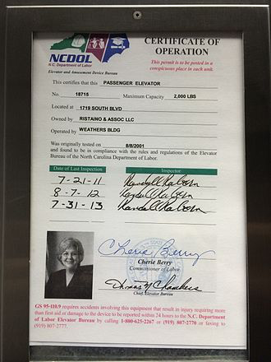
NC Executive Officials
The Governor and Lt. Governor are the top 2 officials
NC Council of State
A group of officials elected by the people in NC that run various departments
Led by the Lt. Gov.
NC Cabinet
These officials are “secretaries” appointed by the Governor
Includes other various departments

Slide 18
Local Executive Government
Mayor-Council government
Separate legislative (city council) and executive (mayor) branches.
There are strong and weak mayor plans.
Council-Manager
Voters elect a city council.
City manager runs the city. Appointed by the city council.
If the manager does not do a good job, he can fired by the council.
Commission government
Separate departments led by a commissioner. The commission has executive and legislative powers.

Slide 19
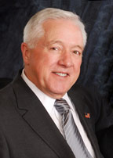
Holly Springs
Holly Springs has a council-manager form of gov’t
5 board members on the city council, plus the mayor, plus a city manager that runs the day-to-day operations.
Responsible for carrying out ordinances (local laws) and decisions made by the Town Council
Dick Sears is the Mayor
Charles Simmons is the Town Manager

Slide 20
Executive Branch Summary
 | National | State | Local
Led by 2nd in command | President Vice Pres | Governor Lt. Gov. | Mayor
Main job | Enforcing laws | Enforcing laws | Enforcing laws
Structure | Cabinet (Dept Secretaries) and Agencies | Council of State and Governors Cabinet | Mayor-Council Council-Manager Commision
Qualifications for leader | 35, native born, live in US for 14 yrs | 30, US citizen, live in NC for 5 years | Set by town
Law Enforcement | US military | Nat’l Guard | Local Police Sheriffs (County)
Powers and Roles | 7 roles (see notes) | Similar to Pres, just at state level | Set by each municipality

Slide 21
Judicial Branch
NC Court System

Slide 22
NC Courts Hierarchy
NC Supreme Court
NC Court of Appeals
NC Superior Court
NC District Court

Slide 23
NC District Court
NC District Courts - original jurisdiction for misdemeanors, juveniles, and civil cases dealing with less than $10,000.
Cases appealed from the NC District Court go to the NC Court of Appeals.
All judges in NC are elected by the people to 8 year terms.

Slide 24
NC Superior Court
NC’s Superior Court – O.J. in felony cases and civil cases dealing with more than $10,000.
Cases appealed from the NC District Court go to the NC Court of Appeals, except for 1st Degree Murder cases resulting in the Death Penalty – they go straight to the NC Supreme Court.

Slide 25
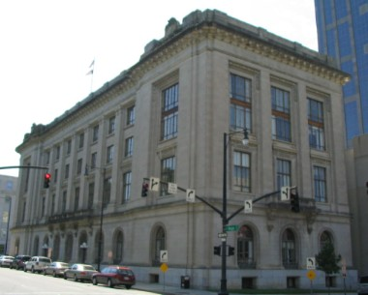
NC Court of Appeals
NC’s Court of Appeals hears all reviews of cases from the District and Superior Courts. (Appellate jurisdiction)
Made up of a panel of 15 judges state wide.
Only 3 judges sit in on each case.

Slide 26
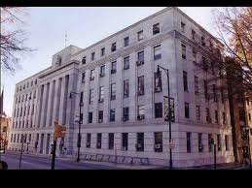
NC Supreme Court
Highest court in the state
Made up of 7 SC Justices
Hear all cases appealed from the lower courts in NC

Slide 27
Local Courts
Local courts are established by the state and oversee a county. Each county seat has at least their own district court.
Wake County has two courthouses, both in Raleigh, that hear different issues
District, Superior, Family, Traffic, Small Claims, Drug Treatment

Slide 28
Local Court Officials
Clerk of Court
Numerous functions: matters dealing with wills and estates, adoptions, foreclosures, etc…
Also responsible for all record-keeping functions of the district and superior courts
District Attorney
Elected position with numerous ADA’s. Various units that prosecute offenders throughout the county.
Magistrates
Officers of district courts; they issue arrest and search warrants, set bail, accept guilty pleas in minor cases, etc..
Public Defender
Represents those that cannot afford a lawyer

Slide 29
Judicial Branch Comparison
 | National | State
HIGHEST LEVEL Number of judges Jurisdiction Type | US Supreme Court 9 Original & Appellate | NC Supreme Court 7 Original & Appellate
Elected or appointed? How long? | Appointed; Serve for life | Elected; 8 yr terms (must retire before 72)
MID LEVEL How many? Number of judges Jurisdiction Type | US Court of Appeals 13 Panel of 3 Appellate Only | NC Court of Appeals 1 - in Raleigh Panel of 3 Appellate Only
LOWEST LEVEL Jurisdiction Type | US District Courts Original Only | NC District & Superior Courts Original Only
Only level to have: | Jury trials | Jury trials (in both)

